Slide 1
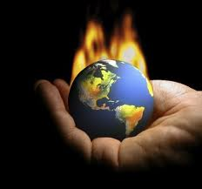
Unit One Part two Pages 76-99
Terms to know for this section

Slide 2
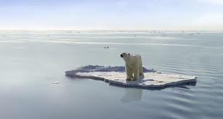
Canada’s Climate System
Climate
Maritime climate
Continental climate
Air mass
Polar jet stream
Westerlies
Front
Warm front
Meteorologist
Weather

Slide 3
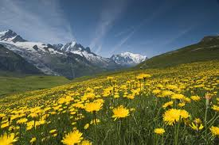
Canada’s Natural Vegetation System
Biome
Boreal
Coniferous
Deciduous
Natural vegetation
Tree line
Tundra
Temperate rainforest
Temperate

Slide 4
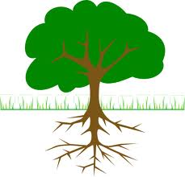
Canada’s Soil System
Fertilizer
Pesticide
Soil profile
Humus
Podzol
Chernozem

Slide 5
Canada’s Water System
Wetland
Runoff
Drainage basin
Watershed
Drainage divide

