Slide 1
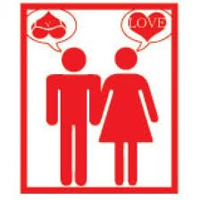
Love vs. Lust

Slide 2
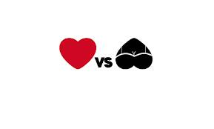
Love vs. Lust
Love develops gradually over time. Infatuation occurs almost instanteously
Love can last a long. It becomes deeper and more powerful, lust is short lived
Love accepts the whole person, imperfections and all. Lust flourishes on perfection- you have an idealized image of your partner, and you can only show them your good side

Slide 3
Love vs. Lust
Love is more than physical attraction. Lust brings out jealously and obsession. It causes you to neglect other relationships.
Love survives arguments. Lust glosses over arguments

Slide 4
Love vs. Lust
Love considers the other person. Lust is selfish
Love is being in love with a person. Infatuation is being in love with love

