Slide 1
Our need for relationships

Slide 2
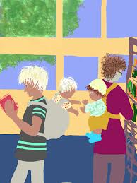
positive relationships
It is important to develop positive relationships during a lifetime. Many needs are filled in positive relationships
1. Social Needs – the need to be involved , belong and function within society. A variety of personal needs such as food, love and belonging, and the need for human socialization can be provided by social groups. It would be very
difficult for the
majority of people
to live totally alone.

Slide 3
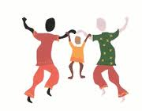
positive relationships
Emotional support needs- relationships with significant others such as parents are critical to a developing child. Parents need to talk with children and show interest in their activities as well as provide love and attention. The amount of emotional support that a young child receives can greatly influence relationships in the future.
The development of peer relationships, dating and friendship help meet the emotional need of many individuals

Slide 4
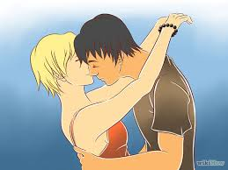
positive relationships
3. Physical needs- human beings have many physical needs which can be met in relationships. Basic needs for food, clothing and shelter are provided by the family unit and children depend on adults for satisfaction of these basic needs. We desire the physical warmth and companionship found in relationships

Slide 5
positive relationships
4. Financial Needs- with increasing age and dependence, financial needs become more and more important. Young people sometimes are unaware of the existence of money.
Some teenagers get jobs to contribute to family income, take trips, continue their education, or cover personal expenses.
A job can also meet other needs. It can create opportunities for new relationships, enhance self concept and greater independence

Slide 6
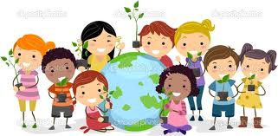
positive relationships
5. cultural needs- our culture is the total of everyday life. It is the way we act and react in our work and personal lives. Through relationships we learn about our cultural backround and family traditions

Slide 7
positive relationships
6.intellectual needs – mental stimulation and the sense of thought connectedness is enjoyable in many relationships

Slide 8
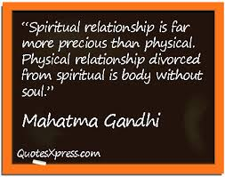
positive relationships
Spiritual Needs- some relationships provide support for personal beliefs, such as living the way one believes one should

