Slide 1
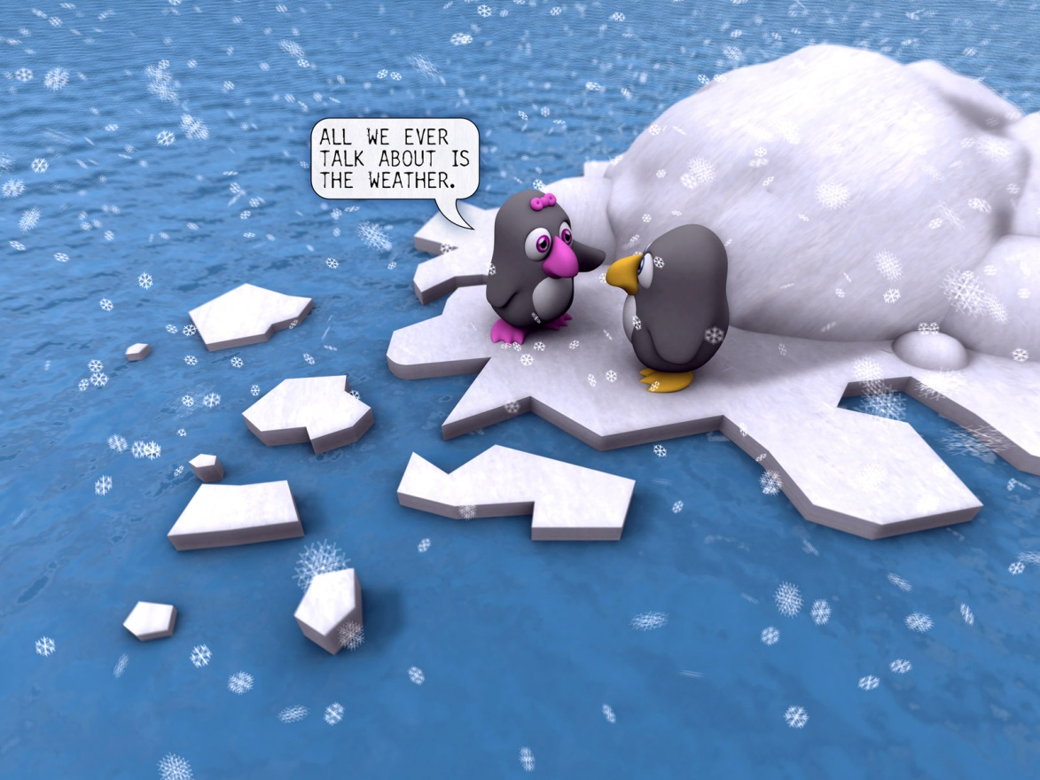
Relationships Unit 2
Alone or together?

Slide 2
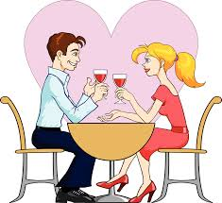
Alone or Together?
Humans are social beings. We like to spend time with others, go out with friends, have people into our homes, join in group activities and date

Slide 3
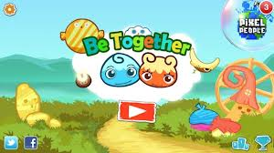
Alone or Together?
Most people also like to have time to themselves establishing a balance between “people time” and “alone time”. It is an important part of determining the number and types of relationships we form in our lives.

Slide 4
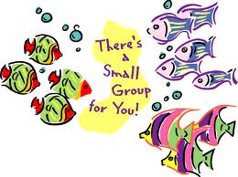
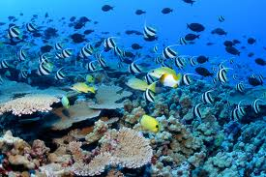
Alone or Together?
Some people are more comfortable in small groups or with one person, while others rather large groups

Slide 5
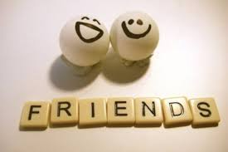
Alone or Together?
Some people have a small number of friends while others spend time with many different people.
“whatever we choose relationships are an important part of your lives”

Slide 6
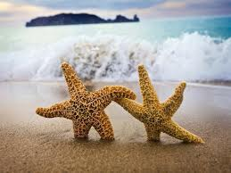
What are some types of Relationships?
People who:
We love
Are in our family
Go to school with
Club/team
Hang out
Teach us
Don’t like
Work with
Attracted to

Slide 7
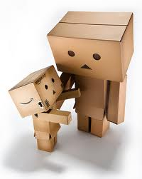
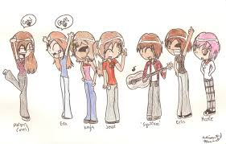
There are many kinds of relationships
1. personal relationships (parent /child)
2. group relationships (friends in class)

Slide 8
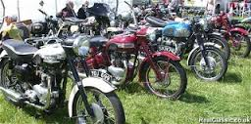
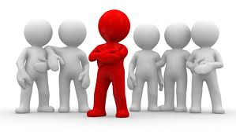
There are many kinds of relationships
3. formal relationships (organized clubs)
4. authority based relationships (supervisor/employee)

Slide 9
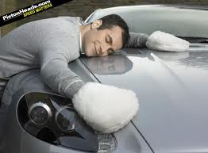
There are many kinds of relationships
5. interpersonal relationships (person and nature or material pocessions and objects

Slide 10
There are many kinds of relationships
Many relationships are a combination of these forms. Each relationship has many elements and characteristics which makes each relationship unique
Your relationship with yourself strongly determines your quality of relationship with others.

Slide 11
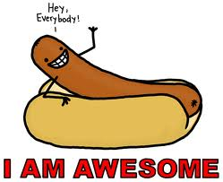
Self esteem is important because we need a sense of self worth. Our sense of self worth or lack of it, affects all that we do in life..

