Slide 1
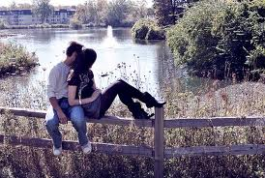
Six stages of a Relationship
Love vs lust

Slide 2
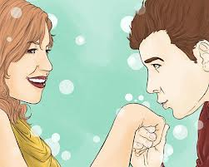
Six stages of a Relationship
1. people display their availability by looks, bumping, or generally inventing ways to be with each other after ascertaining mutual physical interest
2. actual contact is made

Slide 3
Six stages of a Relationship
3. each person tries to be who s/he thinks the other wants him/her to be.
4. people are learning to accept each other for who they really are. This stage may be characterized by multiple break ups and make ups.

Slide 4
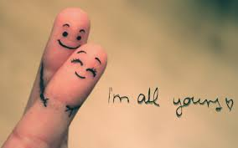
Six stages of a Relationship
5. the disagreements are fewer and the comfort level is greater between partners. They have learned to complement each others strengths and weaknesses.
6. feelings of jealousy cease to exist

