Slide 1
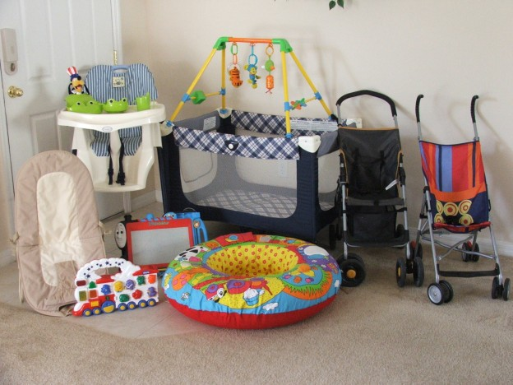
Baby Equipment Safety

Slide 2
High chair safety
The majority of injuries from highchairs are caused by children climbing out , sliding off the seat or strangling on unfastened straps, or tipping over
Chair should have a wide base
Always use the straps!!
The buckle should be difficult for the child to open
Lock the wheels

Slide 3
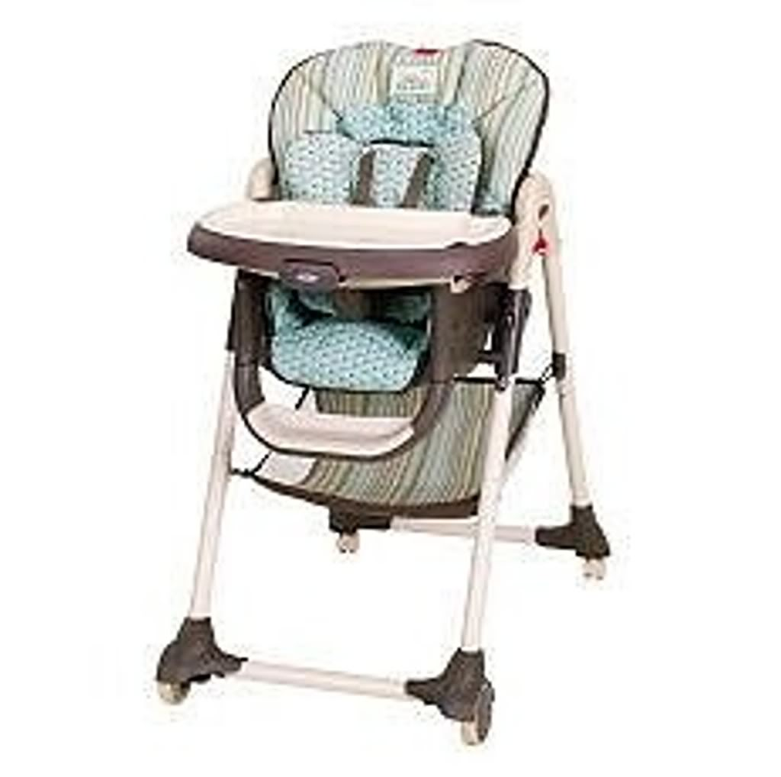
Well padded seat
No sharp edges along the front of seat to harm babies legs
Be very careful in using restaurant highchairs

Slide 4
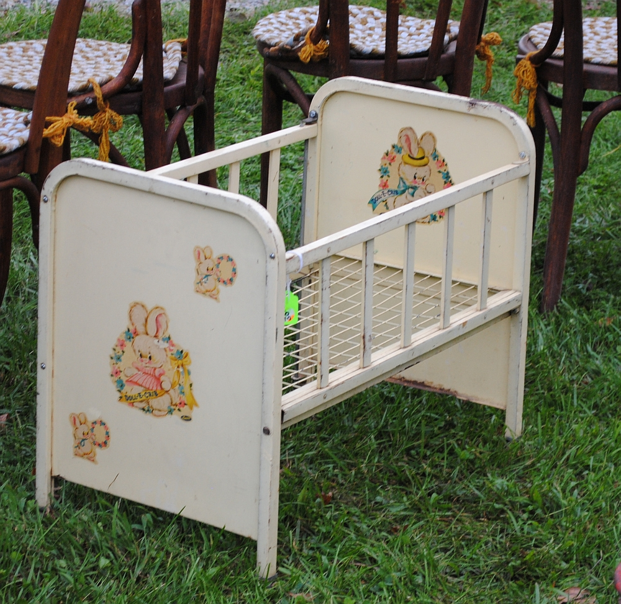
Crib Safety
1000’s of babies are injured each year due to crib injuries
Infants heads sometimes slip between the slats

Slide 5
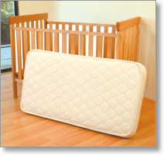
When buying a new crib:
Space between slats should be less than 2and3/8 inches..a can of soda should not fit through
Corner posts should not be higher than 1/16 of an inch above the top of the end panel…clothing could get caught on it
Check hardware often
Mattress should be firm

Slide 6
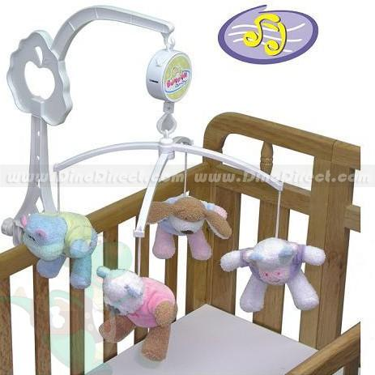
Mattress should fit snuggly.. No more than 2 fingers fit between
NEVER put crib by window
Make sure mobiles are not in reach
Only use lead free
paint
* Remove all plastic
wrap

Slide 7
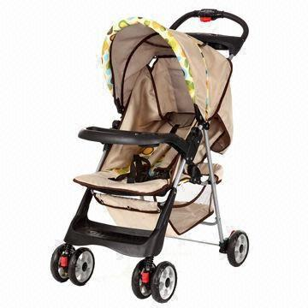
Stroller Safety
Infant stroller should allow the child to lie flat or recline
Never leave an infant sleeping unsupervised in a stroller…could wiggle forward, slip through a leg opening

Slide 8
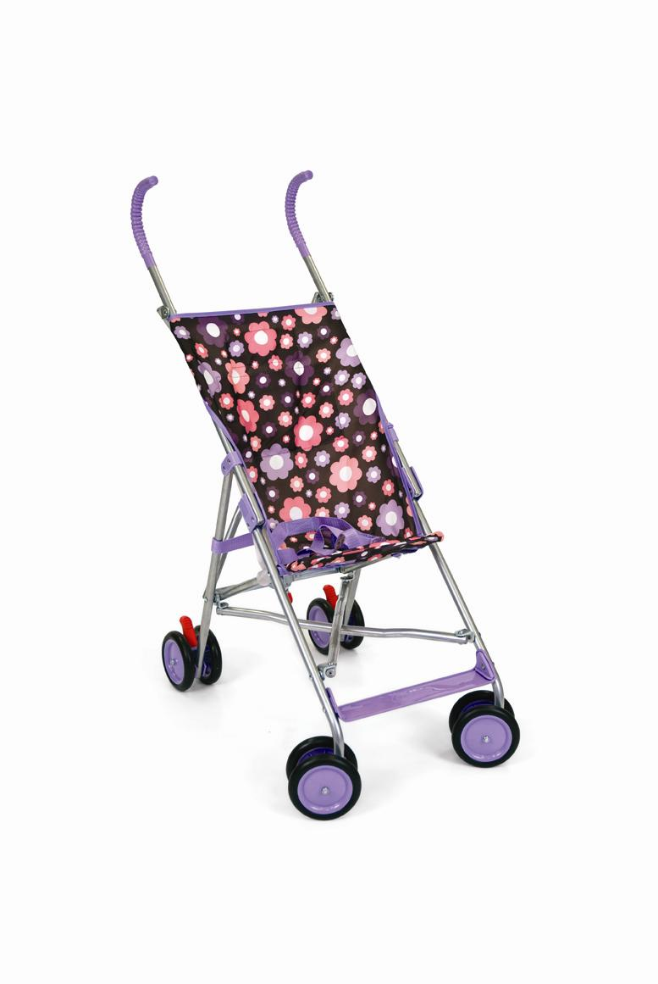
Tips for all stroller types
Keep child away from stroller when folding it
Make sure there is a seat belt
NEVER leave a child alone
Make sure it has brakes
Never use a pillow or
Blanket as a mattress

Slide 9
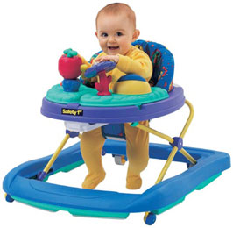
Walker Safety
Walker accidents occur in three ways:
1. falling down stairs
2. tipping over when the walker hits an edge of carpeting
3. burns….touching hot oven doors, heaters or fireplaces

Slide 10
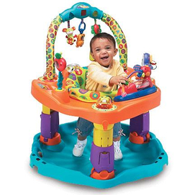
Activity Center
Better choice..can rotate, but not walk freely

Slide 11
Toy safety
Many toys have warnings on them if they have hazards for small children
Ages are listed on packages
Many toys can be choking hazards for infants
Hidden dangers:
Small pieces could get lodges in childs throat
Sewn on eyes and nose could be swallowed
Ball shaped pieces may come loose…get stuck in throat

