Slide 1
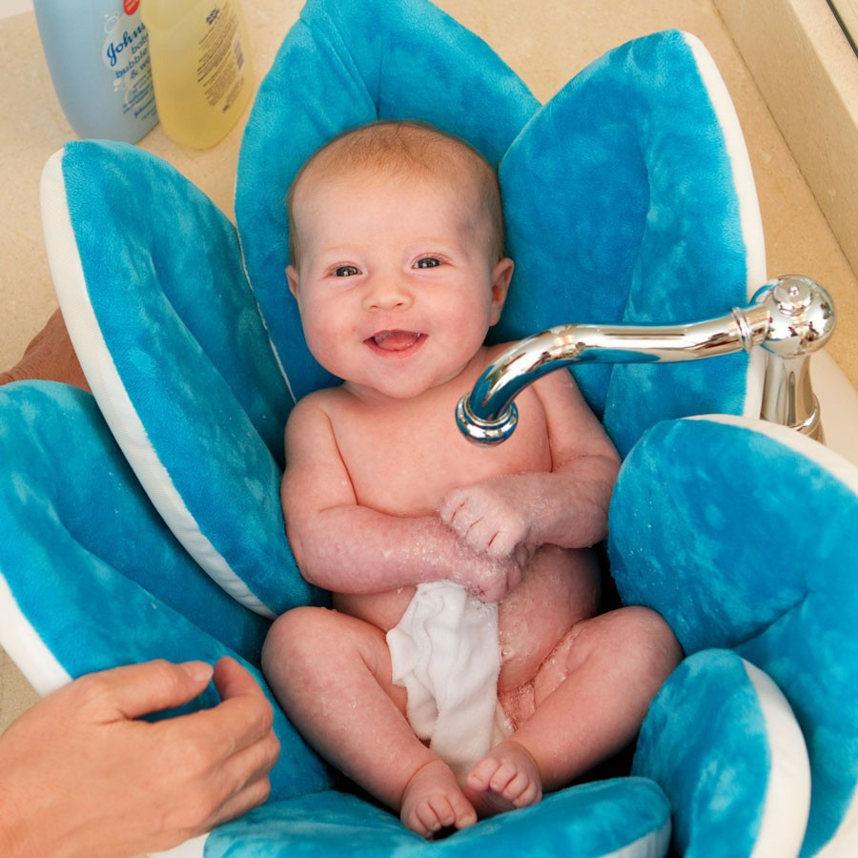
Taking Care of Baby

Slide 2
Changing Baby
Change infant in a safe place where the infant cannot roll away
If using a change table, make sure it has a belt or rails.
On the floor on a change mat is the safest

Slide 3
Changing con’t
Disposable diapers are used most often
Keep diapers, wipes and cream within reaching distance

Slide 4
Discussion questions
1. How often do you think an infants diaper needs to be changed per day?
2. Does the number of changes vary from a new born to a one-year-old? Why?
3. Describe some characteristics of easy to use infant clothing.
4. What type of infant clothing must be flame retardant?

Slide 5
Bathing an infant

Slide 6
Points to remember
1.Never leave an infant alone in a bathtub!!
2. Always bath infant in a warm comfortable environment, free from drafts
3. Keep all supplies within reach
4. Bathe an infant every two-three days
5. Wash your hands before bathing baby
6. Use this time to communicate with baby

Slide 7
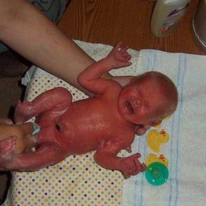
Sponge bath
Should be given until the umbilical cord drops off, then you can use a tub.
You need:
Two large bath towels
Cotton balls
Soft wash clothes
Infant shampoo and soap

Slide 8
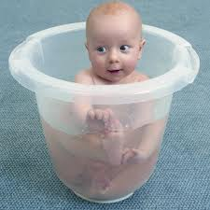
Tub bath
Once the area around the navel is dry and healed an infant is ready for a tub bath
You can use *kitchen sink *basin or * infant tub
2-3 inches of water is all that is necessary!!!!!
Not too hot!! Test it with your elbow.

Slide 9
Questions
1. when can an infant be bathed in a tub?
2. how many inches of water should be used?
3. how often should you bath on infant?
4. Which body part should be cleaned first? Last?
5. How can a tub be made non slippery?

Slide 10
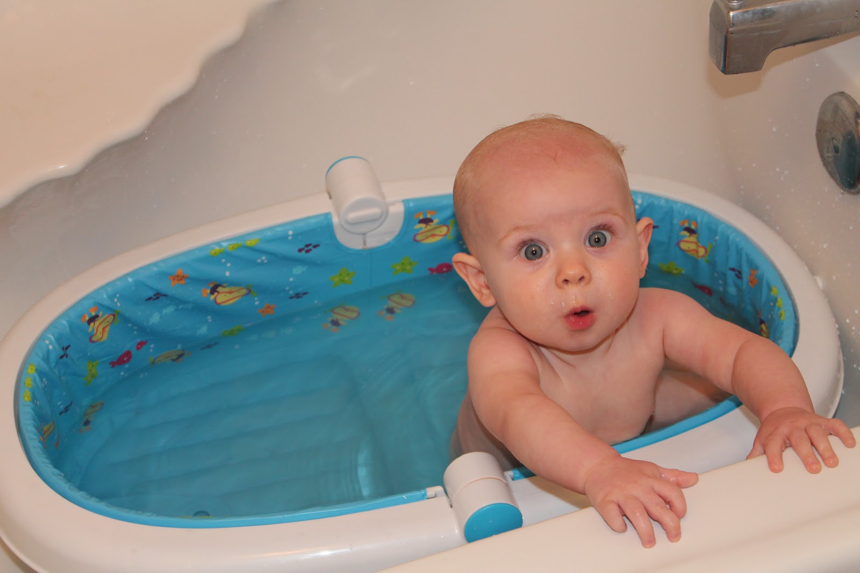
Careful!!!!
An infant can drown in 1-2 inches of water!!!
Just enough to cover its nose and mouth

