Slide 1
Advertising
A form of persuasion

Slide 3
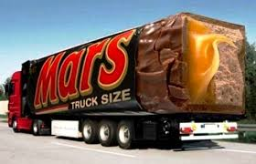
Advertising
Any paid message communicated by Canadian media with the intent to influence the choice, opinion, or behaviour of those addressed by the commercial messages

Slide 4
Advertising
Advertising influences thoughts
It influences feelings
-happiness
- excitement
-worry
- guilt
-stress, panic

Slide 5
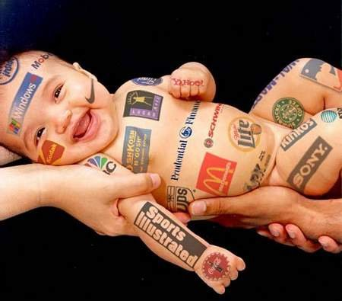
Discuss:
1. What advertising exists in school?
2. What advertising affected you as a child?

Slide 6
Ads
1. why is it effective or not?
2. how would you promote this product to the class?
3. do ads influence your purchasing a product? Why or why not?

Slide 7
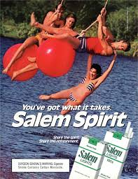
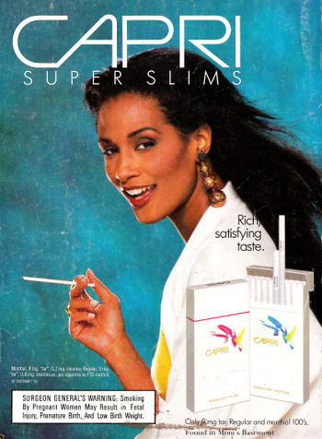
Marketing
Who is the target audience for tobacco companies?
What are the marketing strategies?

Slide 8
Marketing
Marketing is all other related materials and actions used to sell a product:
-brochure
- coupons
- free gifts
- contests
- attractive displays
- taste tests
-packaging
-placement (bars at gas stations
-familiar faces

Slide 10
Brochures
Brochures

Slide 11
Coupons

Slide 12
Free gifts
magazines

Slide 13
Contests
Win!!!!

Slide 14
Attractive displays
Wow!!

Slide 15
Taste tests
Yum!!

Slide 16
packaging
Eye catching!!

Slide 17
placement
Chocolate!!

Slide 18
Familiar faces
pepsi

