Slide 1
Agriculture
An essential primary industry

Slide 2
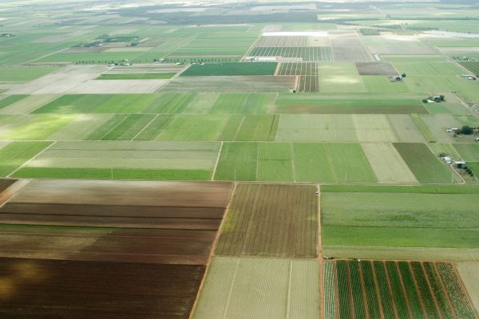
Arable Land
Arable- land that is suitable for growing crops . Only about 7% of Canada’s total land area is arable.

Slide 3
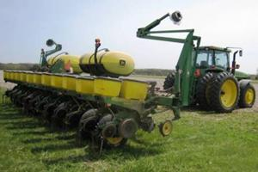
Subsidy
Subsidy- money given to farmers by the government to offset some of the costs, such as expensive machinery or high fuel costs.

Slide 4
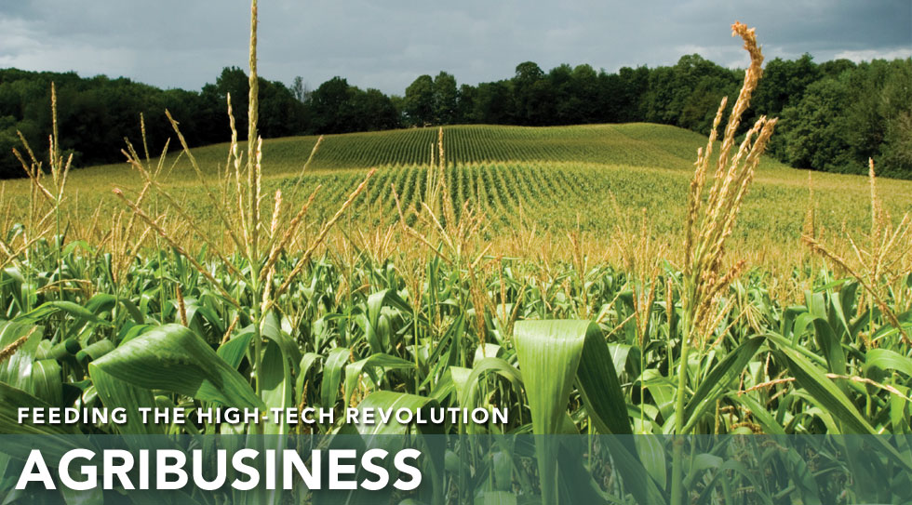
Agribusiness industry
All of the steps involved in putting food on your table, from planting crops to stocking grocery shelves, are part of the agribusiness industry

Slide 5
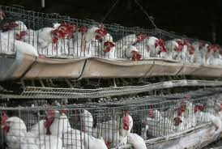
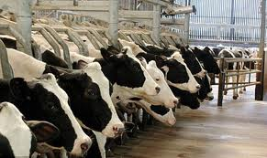
Factory Farms
A large scale form of agriculture where large numbers of animals are kept in confined spaces and treated with hormones and antibiotics to maximize growth and prevent disease

Slide 6
Questions
What are 5 challenges farmers face ? (page 253)
What are 5 factors affecting agriculture? Pg 252
What are free range chickens? Pg 254

Slide 7
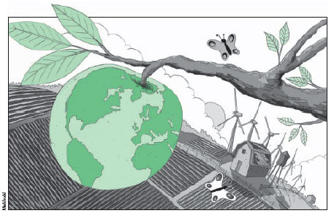
Sustainable Agriculture
Agriculture that will lead into the future . It is a method of farming that is profitable, protects the environment, conserves natural resources and supports the rural community.

Slide 8
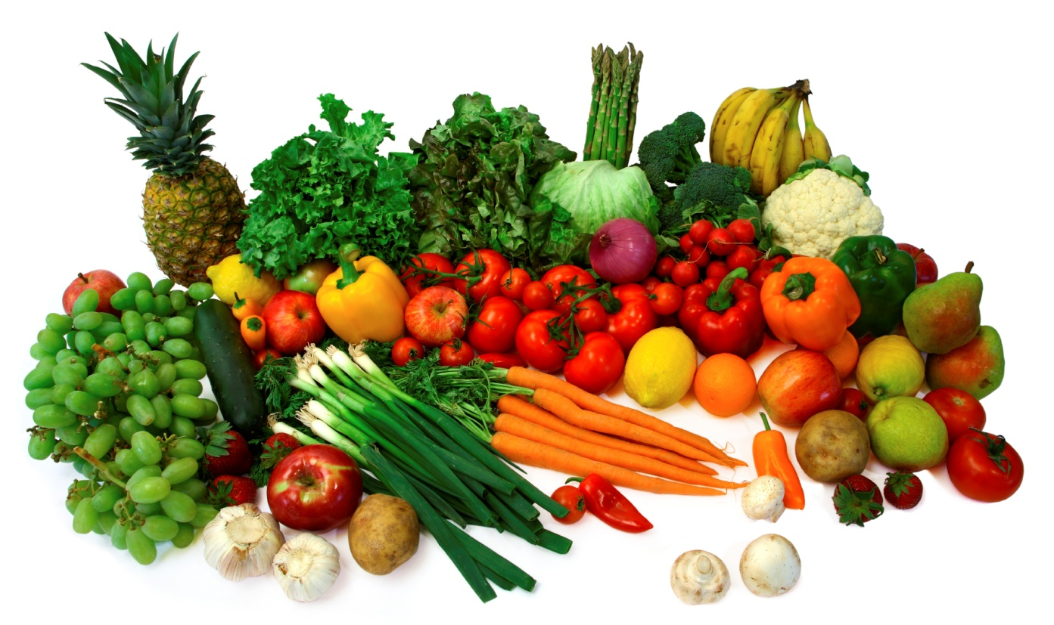
Organic Agriculture
The process of growing plants and animals without using synthetic fertilizers, pesticides, growth hormones, or antibiotics

Slide 9
Questions
Complete questions 1 and 4 on page 257

