Slide 1
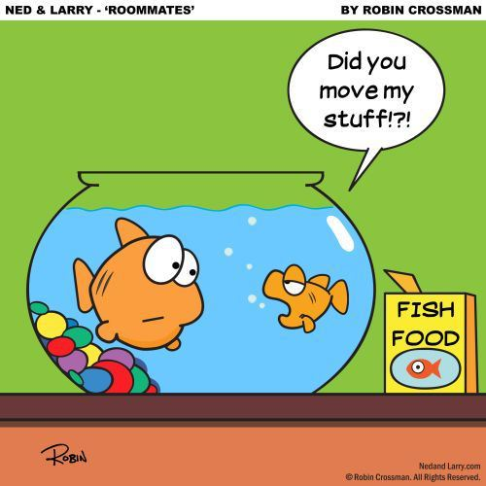
Choosing a roommate
Pg. 68-69

Slide 2
The roommate contract
It is a good idea to have a contract or “living agreement”
It should include:
1. the portion of rent paid by each
2.the share each pays for
utilities
3. how groceries are done

Slide 3
4 how basic tasks like
Cooking and cleaning will
be done.
5. rules on overnight guests and parties

Slide 4
6. sharing of personal effects ...like clothing.
7. the division of materials
when roommates split
8. who brings what
furniture

Slide 5
Each person must sign and date the contract , and get a copy

Slide 6
Page 66- New Roommate
Questions
1. what are some reasons best friends don’t make good roommates?
2. where might one find a potential roommate?
3. write a list of questions you might ask a roommate
4. what conditions would be annoying and unacceptable?

Slide 7
