Slide 1
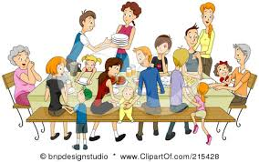
Human Dynamics 2201
Family as Ecosystem Unit 1

Slide 2
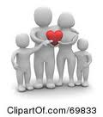
Family
Any combination of two or more persons who are bound together over time by ties of mutual consent, birth and/or adoption /placement and who, together, assume responsibilities for some of the following:

Slide 3
Types of Families
1. Nuclear – 2 parents and 1 or more biological or adopted children, living together
2. Extended - parents, children, aunts, uncles, grandparents and other blood relatives living together or not
3. Blended or recombined or reconstituted composed of parents who have divorced their first spouses, remarried and formed a new family that includes children from 1 or both and/or re-marriage

Slide 4
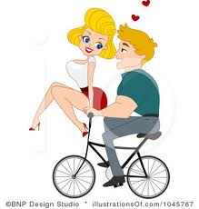
Types of Families con’t
4. Childless- just a couple
5. Lone parent- composed of a parent, most often a mother with 1 or more children

Slide 5
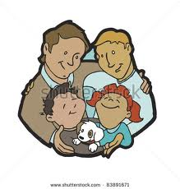
Types of Families con’t
6. Cohabiting couples/common law marriages-
Family arrangements that resemble other forms, but without legalized marriage
7. Gay and Lesbian parents- same sex partners with children

Slide 6
Family as Ecosystem
Ecosystem- relationships among the many species living in an environment and the relationships among those organisms and the non living components of the environment
A family who spends time together can be thought of as an ecosystem. Any change in the relationships within the family will affect all members of the families ecosystem

Slide 7
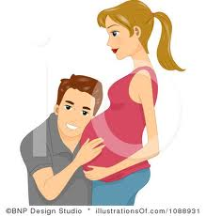
Basic Functions of a Family
1. physical maintenance and care of family members
Food
Shelter
Clothing
Protection
2. addition of new members through birth or adoption - society renews itself through families

Slide 8
Basic Functions of a Family
3. Socialization of children for adult roles. Families prepare children for life
Skills
Values
Attitude
4. Social control of members- within families individuals learn positive values and behavior and receive criticism for negative ones.
5. Production, consumption and distribution of goods and services: food, home maintenance and health care

Slide 9
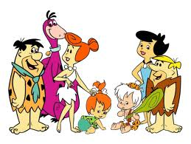
Basic Functions of a Family
Maintenance of family morale and motivation to ensure task performance. Family provides the glue that holds society together. Families through love and spiritual leadership, inspire their members to keep trying.

Slide 10
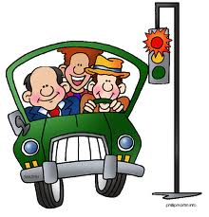
How Families Contribute to the Environment
1 Contributing to the Physical Environment
Recycling- composting, returning cans and bottles, returning catalogues.
Conserving energy and water- turn off
taps while brushing teeth, turn down thermostat, carpool

Slide 11
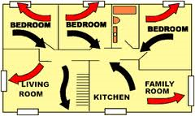
Contribute to Physical Environment (con’t)
Safety- fire escape route, child proofing your home, arrangement of furniture for ease of movement, properly using household equipment and appliances

Slide 12
Emotional and Social Environment
Self Esteem- providing praise, encouragement, recognition, and respect
Provide leadership and Direction- setting limits and rules together, provide positive guidance, participate in leisure activities, have fun, engage in family conferencing.

Slide 13
Emotional and Social Environment
Social support- supporting each other to get involved in extracurricular activities, share tasks, juggle schedules, provide privacy.
Communication and care- listening, family conferencing, handling disputes, respecting others, being aware of financial obligations, appreciation of caregiver

