Slide 1
Forestry
Pp284-295

Slide 2
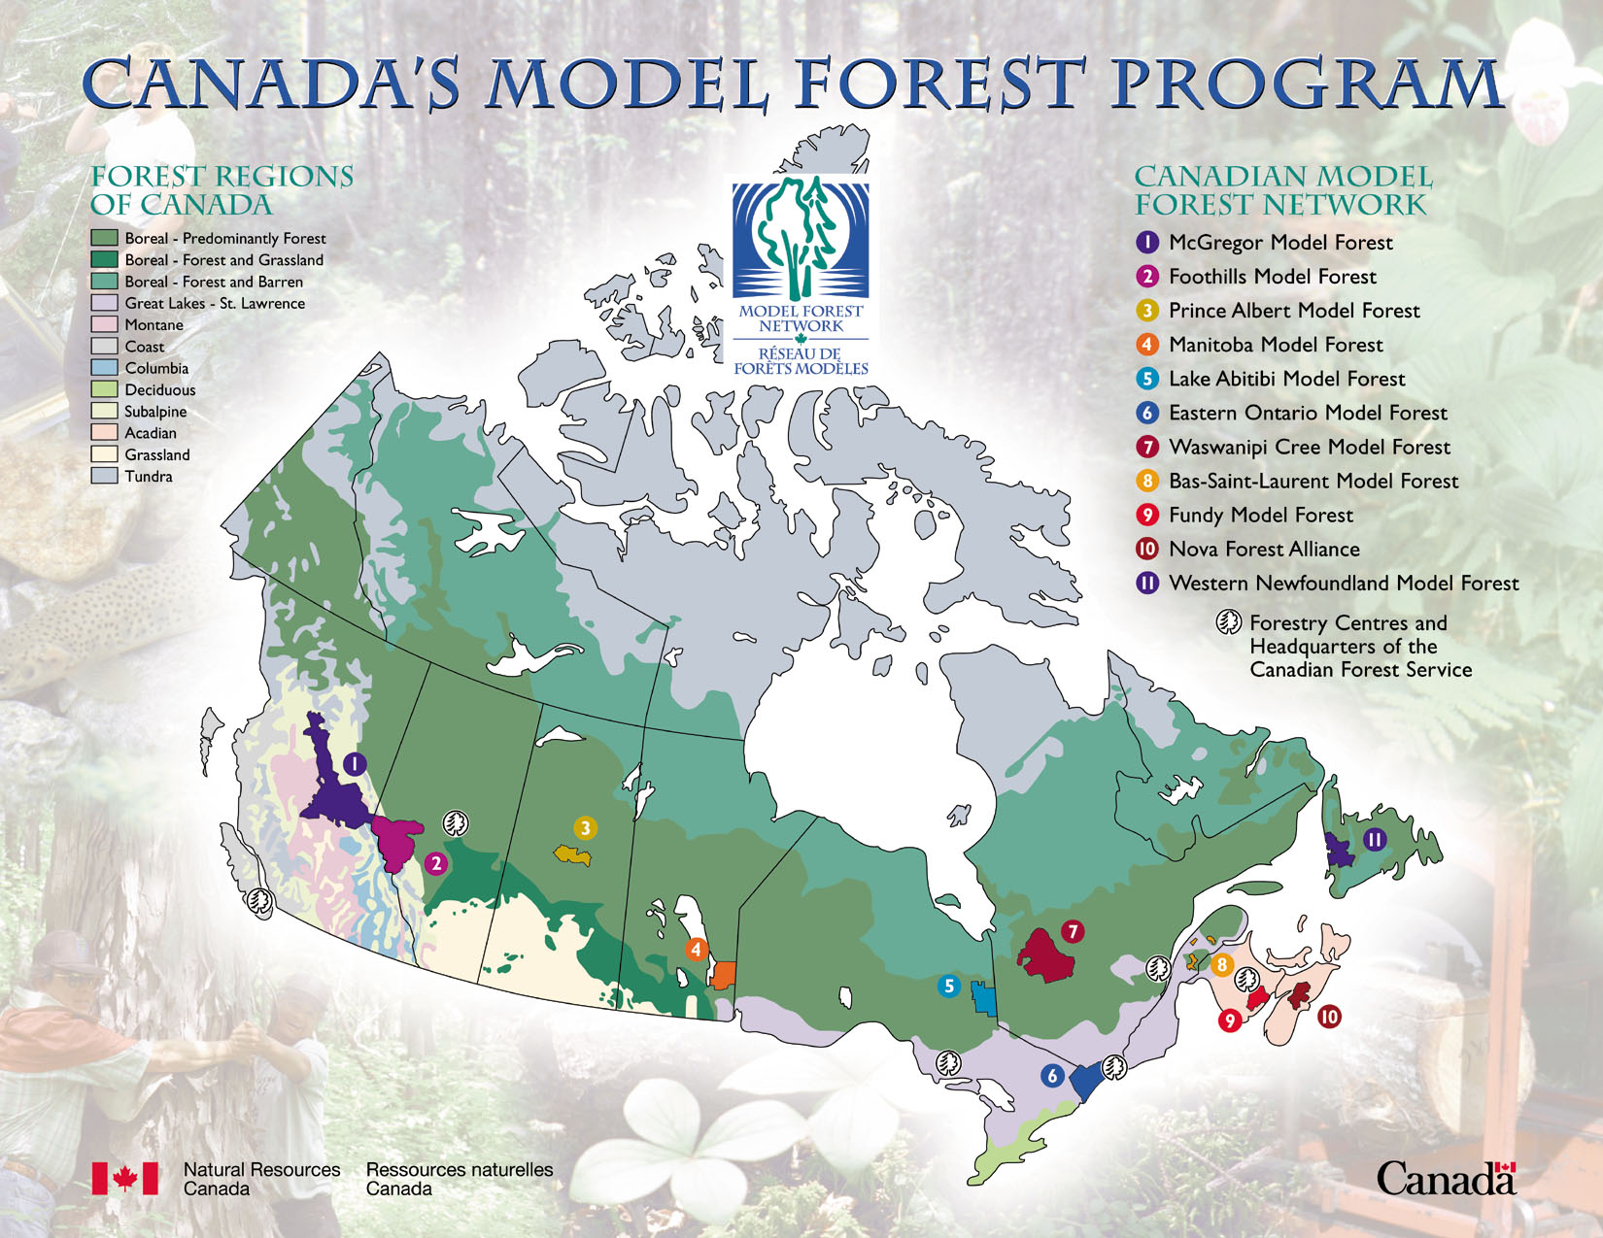
Page 285 Canada’s forest regions

Slide 3
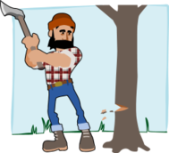
Economic Values
Over 300 communities in Canada depend on forestry
195 000 direct jobs
5 500 people work in forestry in Newfoundland and Labrador
Logging
Pulp and paper
Transportation
Consulting companies

Slide 4
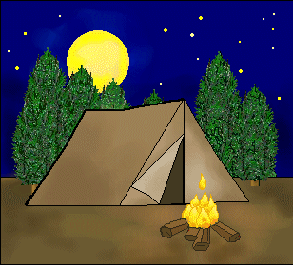
Economic values
Canada exports about $24 billion worth of forest produces each year
Most exports to USA
Forest related tourism brings in billions each year…camping, hunting, resort hotels

Slide 5
Ecological Values
Forests reduce soil erosion, recycle water, and control water flow. They act as a huge air filter, improving air quality by producing oxygen and absorbing carbon dioxide
Forests act as carbon sinks storing carbon that would otherwise contribute to global warming.
Urban forests help create cleaner air for 80% of Canadians who live in towns

Slide 6
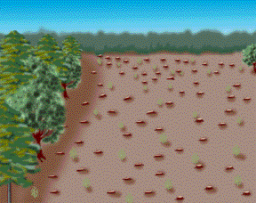
Forest harvesting methods A million hectares are cut down each year in Canada
Clear cutting- clearing all the trees at one time
90% are cut this way
Costs less
Safer
Dessert like landscape
Soil erosion
Loss of biodiversity in variety of tree species and animals
Clear cutting

Slide 7
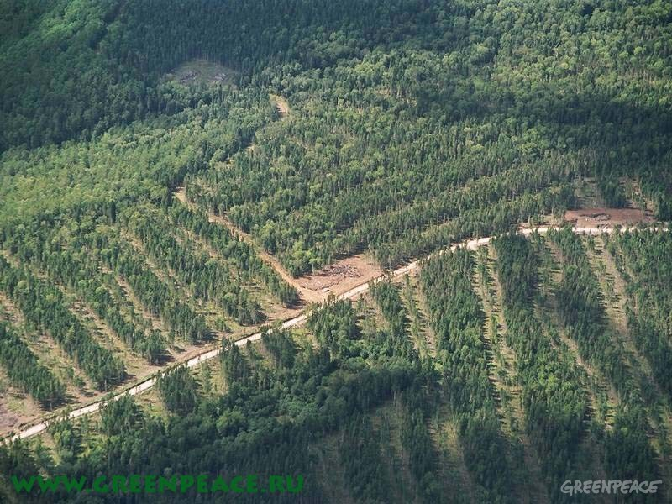
Strip Logging
A form of clear cutting in which long strips of land are cleared leaving some islands of forest intact
Less disruptive to wild life
Allows natural reseeding to take place
Less soil erosion
Strip logging

Slide 8
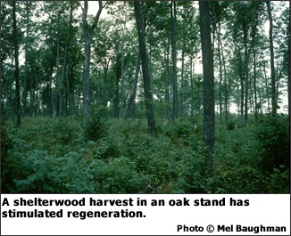
Shelterwood cutting
Trees of same age
Mature trees are cut, remaining trees provide shade for the growth of younger trees and seedlings
When they regenerate the rest of the mature trees are cut

Slide 9
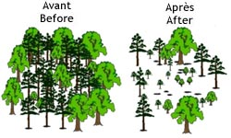
Selection cutting
Different types of trees of various ages
Used to remove diseased trees either individually or in a small group
Usually left to regenerate naturally

Slide 10
Sustainable Forests
A sustainable forest management plan is required for each district in NL and Lab. Harvesting operations need to be planned carefully thinking
about sustainability

Slide 11
Ways to improve Forest Management
1. leave a band of forest around the shores of lakes and rivers, and avoid cutting on slopes to reduce erosion
2. reduce the size of clear cutting
3. set aside large enough areas of the forest to provide intact ecosystems for wildlife or seed reserves for future growth
Read pp 292-294

