Slide 1
Forms of Violence and Abuse
Physical , Sexual and Emotional Abuse

Slide 2
Physical Abuse
Any nonaccidental injury done to another person. The abuse may leave a visible mark- welt, bruise, burn or scratch
Or, it may leave internal injuries, sprains broken bones or a concussion
Whether it is caused by shaking, pushing, slapping or severe beating it is violence

Slide 3
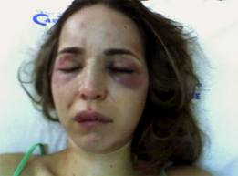
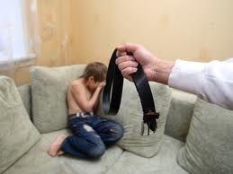

Slide 4
Sexual Abuse
Any forced or unwanted sexual contact
-unwanted kisses to intercourse
Also includes an adult using a child for sexual purposes...it is illegal to touch someone under the age of 14 for sexual purposes.

Slide 5
Sexual Abuse
Sexual assault is one incident, abuse is usually repeated incidents.
Often the person who carries out the abuse knows the victim- parent, sibling, or family friend.

Slide 6
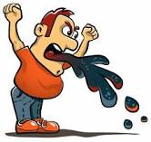
Emotional Abuse
Non physical mistreatment of a person. It destroys feelings of self worth and leaves emotional injuries including:
Lack of trust and security
Problems expressing feelings
Problem liking themselves

Slide 7
Emotional abuse
It is meant to hurt , intimidate, or terrify, often repeatedly
It includes words and actions
Humiliation plays a great part in this form of abuse

