Slide 1
Insurance

Slide 2
Insurance – financial protection against possible loss.
Types of insurance:
- car
- house
-health
- life
- employment
- disability
- travel
- mortgage

Slide 3
Car insurance
-Required everywhere in Canada , its illegal to drive without it
- Proof of insurance is the pink slip
- it must be shown to the police if requested
- the more expensive the car the more the insurance premiums.
- the better your driving record the lower your insurance premiums will be

Slide 4
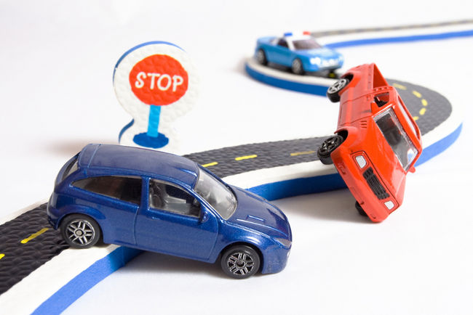
Making car insurance less expensive
1. drive safely
2. chose a safe vehicle
3. Drop any unnecessary portions of your insurance
4. Increase the deductible
5. shop around

Slide 5
Discuss:
What is irreplaceable?
- in a fire
- in an accident
Should insurance be manditory?

Slide 6
Reducing the Risks of Car Theft
1. don’t leave car unlocked
2. don’t leave keys in car
3. keep a photo of your car in a safe place
4. use the theft alarm
5. don’t leave valuables in car in plain view
6. park in well lit areas
7. mark anything that can be removed with a vehicle id

Slide 7
How not to buy a lemon

