Slide 1
Ecozones of Canada
Marine Ecozones
Terrestrial Ecozones

Slide 2
Ecozones
Marine
Pacific
Arctic Archipelago
Arctic Basin
Northwest Atlantic
Atlantic
Terrestrial
Arctic Cordillera
Northern Arctic
Southern Arctic
Taiga Plains
Taiga Shield
Taiga Cordillera
Hudson Plains
Boreal Plains
Boreal Shield
Boreal Cordillera
Pacific Maritime
Montane Cordillera
Prairies
Atlantic Maritime
Mixedwood Plains

Slide 3
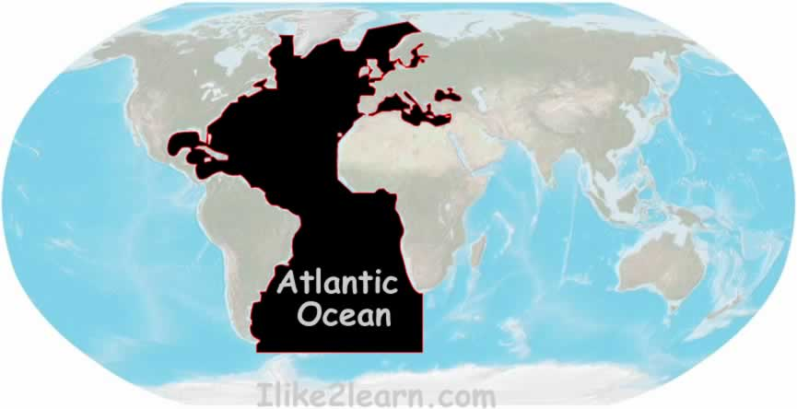
Ecozones
Atlantic Ocean

Slide 4
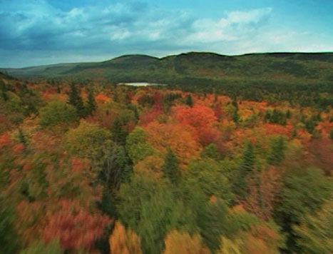
Ecozones
Mixed Wood Plains

Slide 5
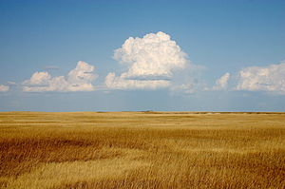
Ecozones
Prairies

Slide 6
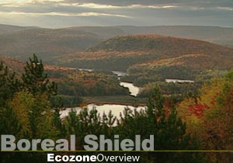
Ecozones
Boreal Shield

Slide 7
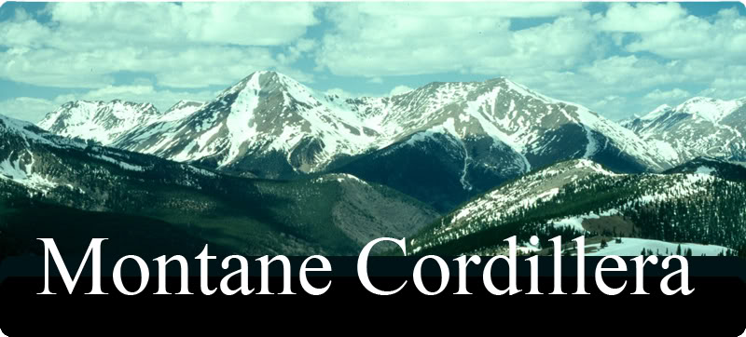
Ecozones
Montane Cordillera

Slide 8
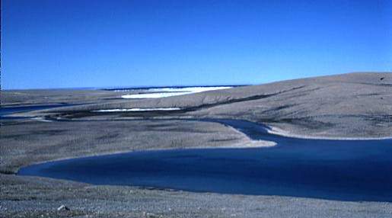
Ecozones
Southern Arctic

Slide 9
Activity
1.Look at the map on p. 100 of your text.
What is the name of the ecozone you live in?
What image comes to mind when you think about that ecozone?

Slide 10
Characteristics of Ecozones
Geology
Climate
Landforms
Soil
Wildlife
Natural Vegetation
Humans
Water

Slide 11
People Affect Ecozones
People affect nature and can affect it in different ways-this is why ecozones include humans and their activities
Humans are accelerating the pace of change in ecozones
Humans cause serious and sometimes irreversible damage. (smoggy air, polluted water, diasppearing forests and animals, collapse of fisheries)

Slide 12
Biodiversity
Some ecozones have many more different species of plants and animals living within them than others
Some places in ecozones such as wetlands are “hot spots” of biodiversity.

