Slide 1
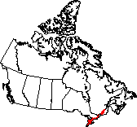
Mixedwood Plains

Slide 2
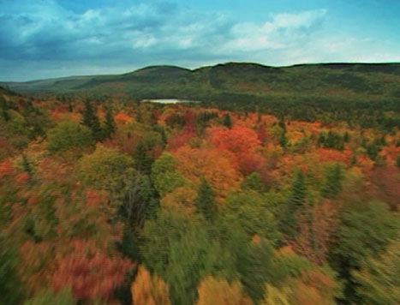
Glossary
Escarpment
Dolomite
Caprock
Differential Erosion
Aggregates

Slide 3
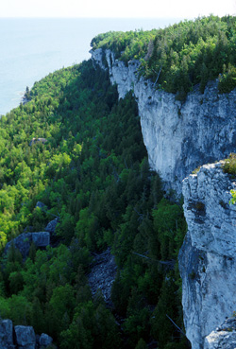
Landscape
The Niagara Escarpment is a 725-kilometre-long cliff.
Winds along western shore of Lake Ontario, up to the tip of Bruce peninsula.
Considered the backbone of this ecozone.
Declared a UNESCO (United Nations Educational, Scientific, and Cultural Organization) World Biosphere Reserve, making it an internationally recognized ecosystem.

Slide 4
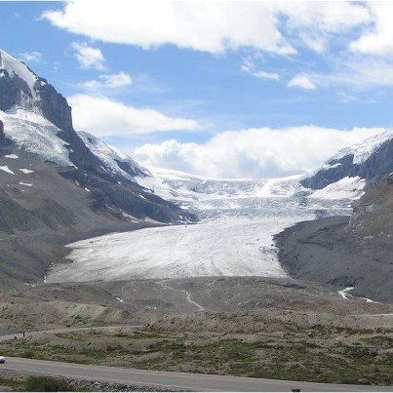
When the glaciers melted at the end of the Ice Age, sand and gravel settled on sedimentary rock in the area.
The rock layers at the bottom of the cliff (shale and sandstone) are softer than the rock layers on the top of the cliff (dolomite limestone).

Slide 5
Case Study
Case study “The Holes in The Niagara Escarpment” pgs. 140-143

Slide 6
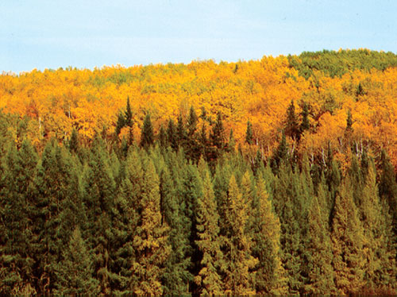
Vegetation
because so many people live in this small ecozone, much of the natural vegetation is gone.
there are some heavily forested areas along some lakeshores.
Agriculture, logging, and city growth have wiped out much of the forests (only 10% of Southern Ontario’s original forests remain)
More than 90% of the wetlands in the area have been converted to farmland or urban areas.
Before the farmland and urban sprawl took over, the area had a mix of coniferous (pines and hemlocks) as well as deciduous (maple, oak, and elm) trees.

Slide 7
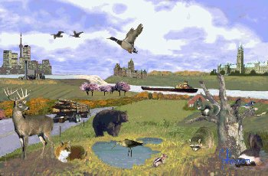
Wildlife
Like the forests, much of the wildlife of this ecozone has been pushed out because their homes (the trees) have been chopped down.
Some species that remain include white-tailed deer, foxes and squirrels.
Other species (coyotes, raccoons, mice, and groundhogs) have adapted to city life but the people living there aren’t too happy with that.

Slide 8
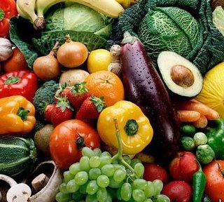
People
smallest ecozone in Canada (9% of total land area of Canada) but has the most people (60% of the country’s population live here).
more than half the top quality agriculture in Canada is in this ecozone.
Many fruits and vegetables grown there.

Slide 9
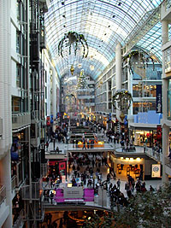
People
Industrial Heartland – many products (designer clothes, cars, furniture, food) are manufactured here.
The many banks and corporations around the western shore of Lake Ontario has led to the nickname The Golden Horseshoe.

Slide 10
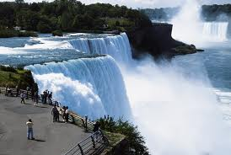
People
Lots of tourism – Niagara Falls, CN Tower, Royal Ontario Museum.
Sports – baseball, hockey, football, and basketball franchises.
Lots of cottage areas.

Slide 11
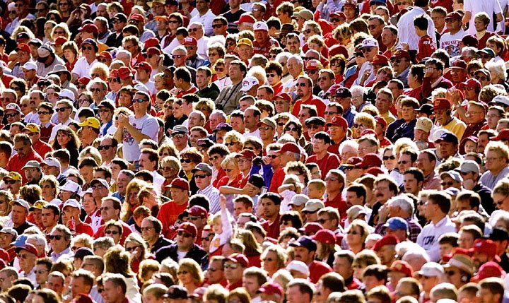
People
More than 100 people per square kilometre.
12.8 million people in Ontario – 90% of them in the Mixedwood Plains
8 million people in Quebec – 80% of them in Montreal, Quebec City, and Trois Rivieres, all found in Mixedwood Plains

Slide 12
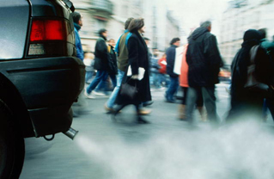
Threats
quarries on the Niagara Escarpment – holes are being blasted into the rock.
expanding urban areas threatening forests and wildlife
people breathe in smog caused by cars, factories, and thermal-electricity plants.

