Slide 1
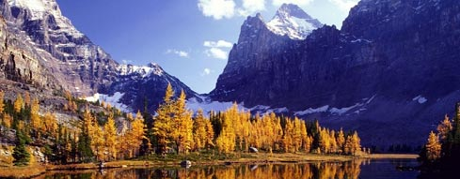
Montane Cordillera

Slide 2
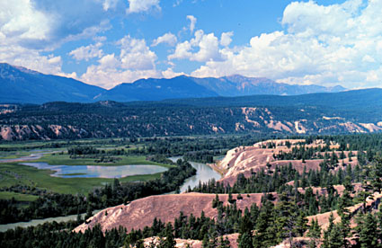
Glossary Words!
Orographic precipitation
Windward
Alpine tundra
Leeward
Mountain pine beetle

Slide 3
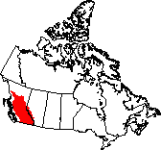
Montane Cordillera
Landscape
This eco zone lies mostly in British Columbia, with 10% in Alberta
It consists of rows of mountains separated by wide valleys and plateaus (areas of elevated, flat land)
The montane cordillera is a land of exceptional natural history

Slide 4
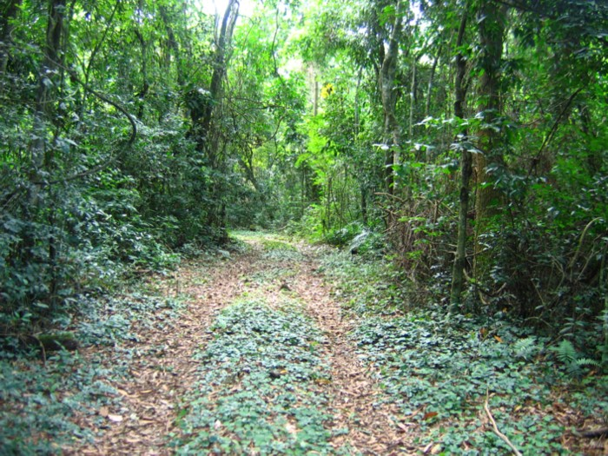
Montane Cordillera
Natural Vegetation
Natural vegetation varies greatly in the Montane Cordillera. This depends upon the location on mountains or in valleys
Why does vegetation vary?
Orographic precipitation

Slide 5
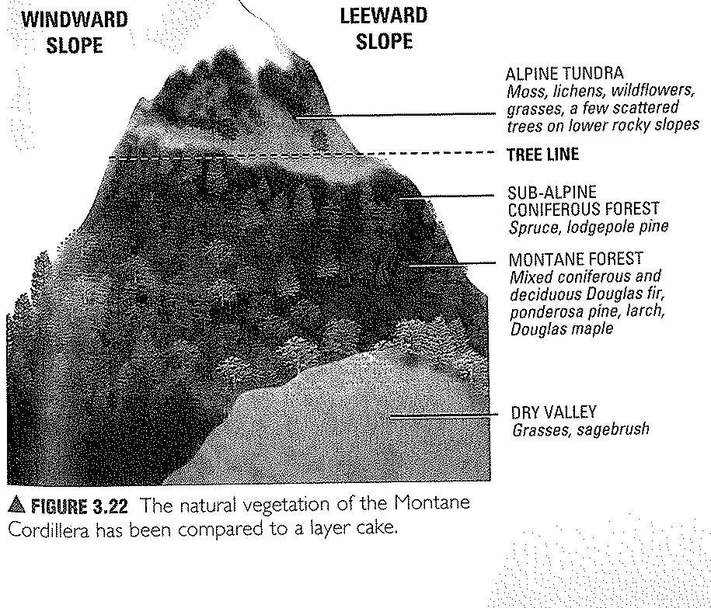
Page 123 (fig. 3.22)

Slide 6
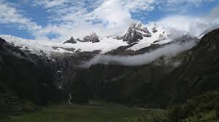
Orographic Precipitation
Windward Slopes of Mountains
These slopes are located on the west side of the mountain ranges where wind brings moisture from the Pacific.
Most precipitation is found on the windward side of mountains, so the lower parts of windward slopes are dense with coniferous forests (spruce, pine).

Slide 7
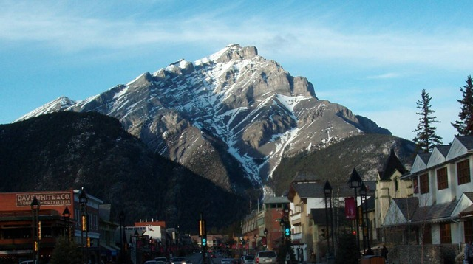
Orographic Precipitation
Near the Top of the Mountain
The mountain top is too cold and windswept for trees to grow, so alpine tundra vegetation grows here (moss, lichen, and grasses).
Mountain Peaks
Have permanent ice.

Slide 8
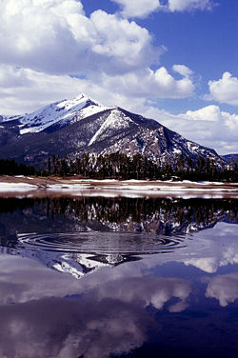
Orographic Precipitation
The leeward side of Mountains
This side of the mountain is more protected and therefore does not receive much precipitation.
Grasses and sagebrush grow in valleys of these regions.

Slide 9
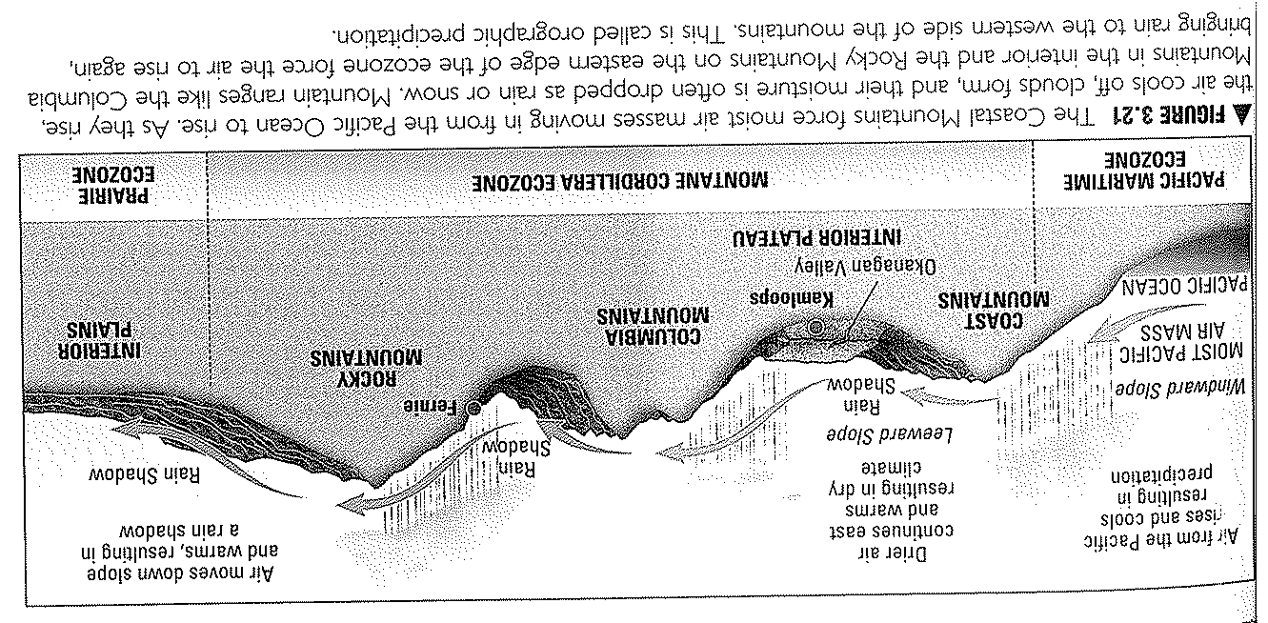
Orographic Precipitation

Slide 10
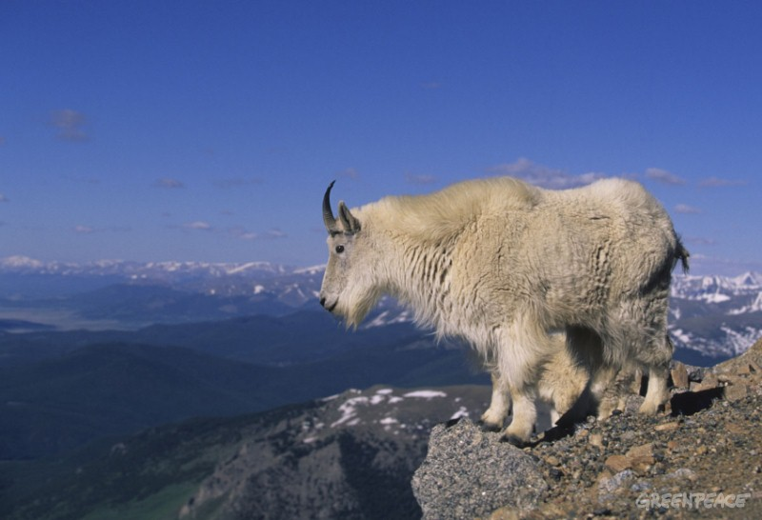
Wildlife
Big horned sheep
Mountain goats
Grizzly Bear
White tailed deer
Mink

Slide 11
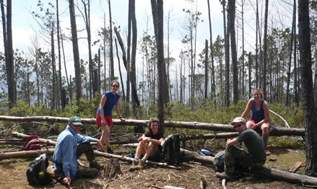
People
Forestry
Coniferous forests of the lower and middle slopes are a great resource for logging companies.
Tourism
Hiking, mountain climbing, hunting, fishing, etc.

Slide 12
People
Farming
Climate and soil conditions in valleys provide ideal conditions for fruit farming and vineyards

Slide 13
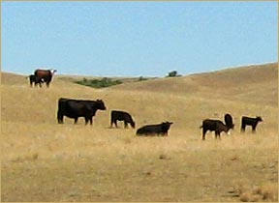
People
Mining
Coal deposits in ancient sedimentary rock provides a great resource for mining companies
Cattle Ranching
Grasslands on interior plateaus are perfect for cattle ranching

Slide 14
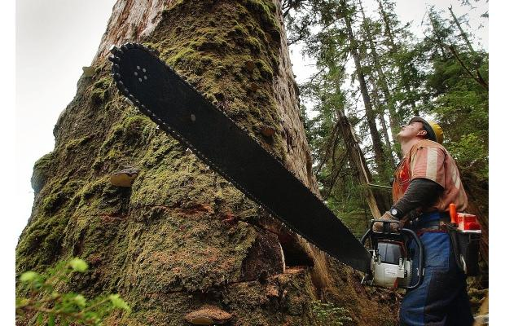
Threats
Logging
Logging, replanting and maintaining forest cover is essential for sustaining wildlife habitats
Urban growth, industrialization, agriculture and tourism are encroaching on grasslands and increasing pressure on water supplies.

Slide 15
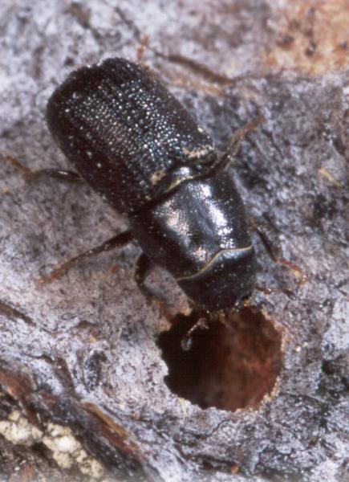
Threats
The Mountain Pine Beetle
Kills trees by eating holes in the inner bark, laying eggs there.
This leaves a mass of dying red trees, costing the provincial economy millions of dollars
Both B.C and Alberta are burning forests in an attempt to contain and kill the pest.

Slide 16
Geolab Challenge
Page 126
Solving A Climate Mystery

