Slide 1
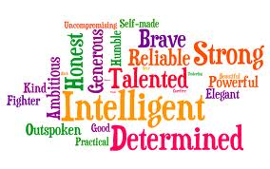
Personal Characteristics
Personal Management Unit 2

Slide 2
Personal Characteristics
1. Values: statements concerning the individuals perception of what is good or bad, right or wrong, important, desirable or undesirable.
Values are the main determinants of human behavior. They influence how an individual judges their own and others behavior.

Slide 3
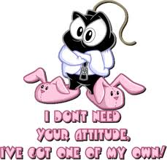
Personal Characteristics
2. Attitudes: the positive, negative or neutral feelings an individual holds about relationships and life experiences( eg.Money,work,friendship, school, etc) Attitudes influence how a person responds within a given context.

Slide 4
Personal Characteristics
Beliefs: ones expectations about what is real. Some beliefs can be irrational and can interfere with the development of positive relationships and responses.
Ex. One has a belief that everyone should love them
One believes that no one should work for a living

Slide 5
Personal Characteristics
4. Interests: activities / experiences that motivate people and provide enjoyment
Painting
Fishing
Reading

Slide 6
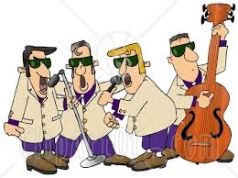
Personal Characteristics
Skills/Aptitudes: refers to capacities to perform a task. Any individual can develop skills in a particular area with exposure, practice, education, and preserverance. Aptitude refers to an innate characteristic that an individual may possess that allows him/her to develop a skill to a higher level
Ex crafts
Athletics
Music

Slide 7
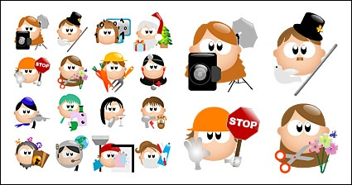
Personal Characteristics
6. Personality: an individuals temperment, attitudes, and style of interacting with people and the world around them , that is modified by life circumstances.

Slide 8
Journal writing # 4 Complete in Portfolio
Personal Characteristics

Slide 9
Self Concept
The way individuals see themselves
Being self aware
It’s the foundation of our personality- affects almost all we do
Involves our feelings about ourselves and mirrors opinions of us- how we project ourselves, helps to develop our goals and realize success

Slide 10
Self Concept
Involves resiliency – keeps our spirits high and adapt when things do not work out as planned
A positive self esteem gives you: - greater ability to deal with change, move ahead despite challenges, and bounce back from adversity and failure
Acceptance of aspects one cannot change about oneself
Recognition that there are aspects under a persons control

Slide 11
Self Awareness
The development of a positive self concept involves an appreciation of who one is, such that an individual can be responsible to ones self and others in a respectful, moral, manner. It also involves the acceptance of those aspects that one cannot change about oneself, and a recognition that there are aspects that are under an individuals control. Awareness of both the internal ( attitude, beliefs) and the external( people in our lives that influence self concept) is critical

Slide 12
Strategies/Factors
Self Concept

Slide 13
Strategies to enhance self concept
1. development of long term plans
2. engagement in positive self talk
3. reduction/elimination of negative self talk
4. avoid sources of negitive influence
5. stress management
6. anger management
7. enhancement of skills/ abilities

Slide 14
Strategies to enhance self concept
8. having a purpose in life
9. development of positive personal relationships
10. interacting with positive people
11. adoption of a healthy lifestyle

Slide 15
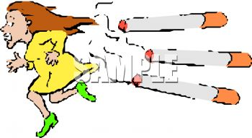
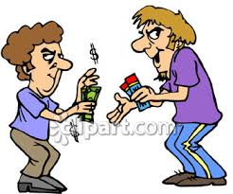
Factors that diminish self concept
1. giving in to peer pressure
2. substance abuse
3. engagement in illegal activities
4. negative self talk

