Slide 1
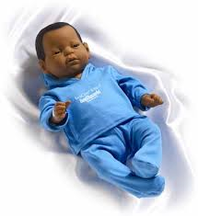
Readiness notes
The baby simulator

Slide 2
Baby Information
Real care baby is an electronic infant simulator that cries to be fed, burped, rocked, and have its diaper changed.
Baby weighs 6.5 to 7 pds, it has a flexible neck and its head must be supported at all times

Slide 3
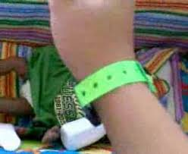
Caring for Baby
When baby cries the student wearing the wristband must pick up baby, listen for chime, then figure out what the baby needs
Feeding
Burping
Diaper change
Rocking
Comfort after a rough handle
Lack of head support

Slide 4
Things that can happen to baby
Breathing sound means baby is sleeping or being rocked
Coughing
Cooing(happy noise)
Sometimes baby is just fussy
Baby cries if he is upsidedown or on his tummy for more than 5 seconds
You have 2 minutes before a missed care is recorded

Slide 5
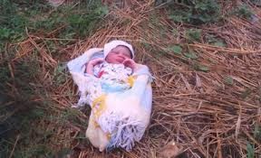
Safety Reminders
Baby may cry while driving….be prepared
Never leave baby alone in a public place
Never care for baby while driving
Never place near stove
Never take off your wristband

Slide 6
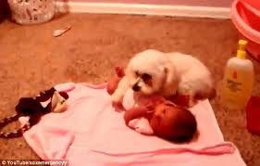
Safety Reminders
Baby must sleep close to you, but not with you
Do not place near water!!($1200)
Keep away from pets!
Use a carseat
Do not operate any type
of equipment while holding baby
Do not allow small children to play with baby

Slide 7
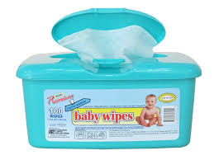
Care and Maintenance
Never immerse baby in water or allow water to come near babies back
Use wipes to clean baby
Baby’s skin stains easily- soaks up inks and dyes :newsprint
Jeans
Pens and markers

Slide 8
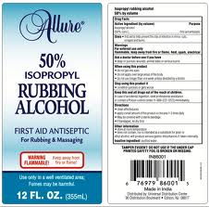
No cleaner will remove all stains
You can try:
Acne cleaning pads
Rubbing alcohol
Nail polish remover
All purpose cleaner

