Slide 1
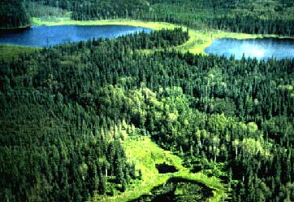
The Boreal Shield

Slide 2
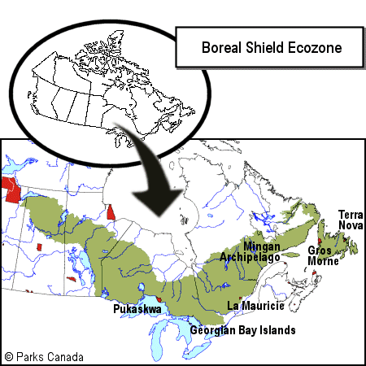
Glossary Terms!
Muskeg
Taiga
Timberland

Slide 3
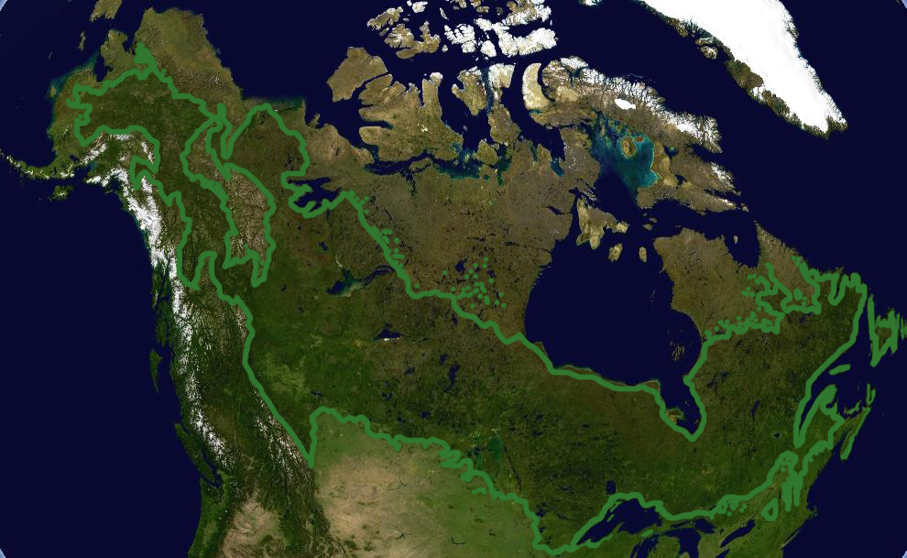
The Boreal Shield
The Boreal Shield is a combination of two important natural features:
The rocky Canadian Shield
The coniferous northern forest
The Boreal Shield is a huge ecozone, in some places stretching over 1000 kilometres wide.
It as been called the Amazon of the North

Slide 4
Landscape
The Boreal Shield has a very distinct look. This is due mostly to glaciers that scraped the land and exposed the granite bedrock, leaving behind thin soils and many depressions.
These depression fill with water creating bogs, swamps and lakes.

Slide 5
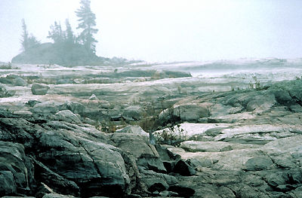
Natural Vegetation
The natural vegetation of the Boreal Shield is well adapted to cold winters and short, hot summers and just enough precipitation to support a dense forest.

Slide 6
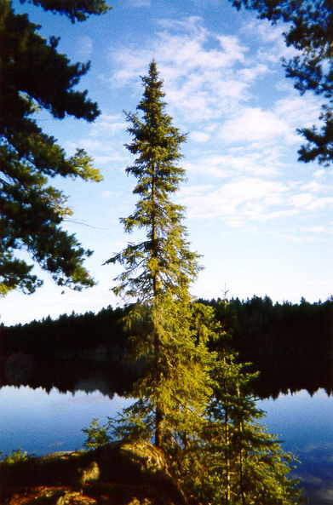
Natural Vegetation
Black Spruce and balsam fir are used in high quantity for the pulp and paper mills.
Hardy deciduous trees like birch and poplar are found on the southern edges of the region.
Lichens and shrubs are also found in this area.

Slide 7
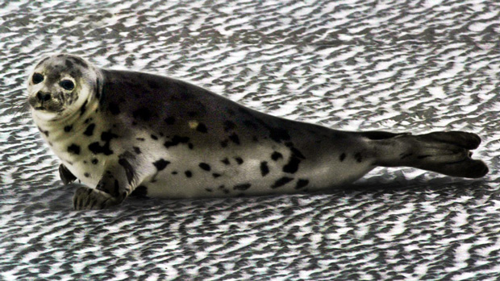
Wildlife
230 different birds live in the Boreal Shield
Aquatic animals
Seals, whales, pike, trout and pickerel
Smaller animals
Beaver, fox, marten, otter
Large animals
Black bear, lynx, coyote, moose

Slide 8
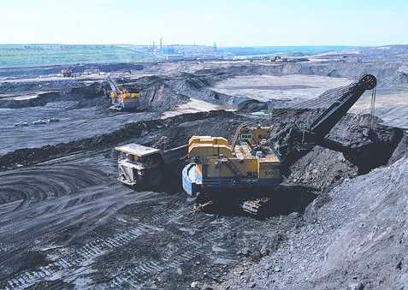
People
About 4 million people live in the Boreal Shield
Mines and mills are major resources in this ecozone.
Remote hunting and fishing lodges create a prosperous tourism industry.

Slide 9
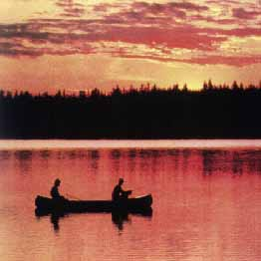
People
Many Aboriginal peoples live in the Boreal Shield
Some maintain their traditions of hunting and fishing while others work in resources, businesses, construction or tourism.

Slide 10
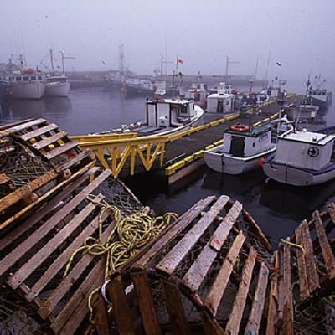
People
In Newfoundland and Labrador, fishing formed the basis of the economy.
However, recent overfishing has led to the collapse of major fish stocks, which have impaired many coastal fishing communities.

Slide 11
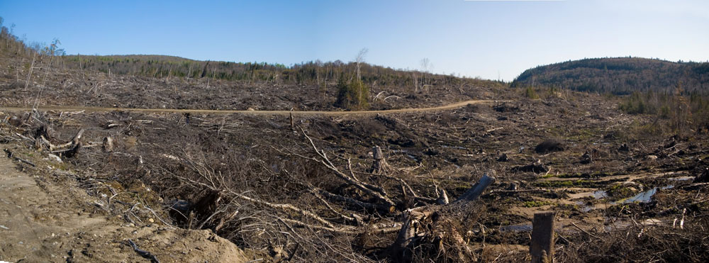
Threats
Logging, mining, the building of oil and gas pipelines, and hydroelectric development all threaten the ecozone.
Forestry industry
Clear-cutting methods leave few trees behind in logging areas
Only a few tree species are being replanted.

Slide 12
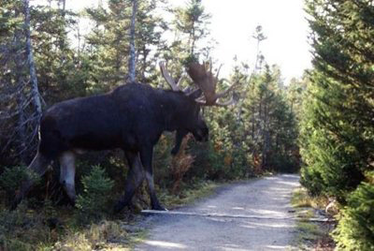
Threats
Roads
Road building through the ecozone force sediment buildup in streams and rivers
Road separate animal habitats, leaving them vulnerable
Road access brings more motorized vehicles into an area leading to more pollution, risk of fire and an overall negative impact on the wildlife.

Slide 13
Activate your Learning!
Page 121
# 1, 2 & 4

