Slide 1
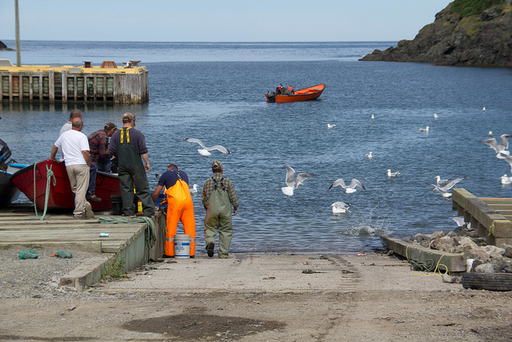
The Fishery
Pp 260-271

Slide 2
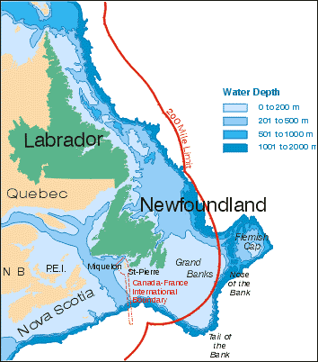
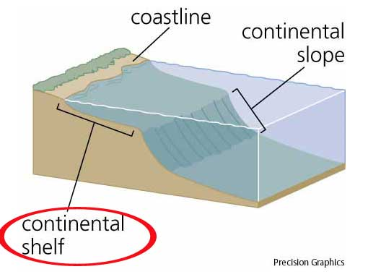
Important terms
Fisheries- commercial fishing operations, mainly on Canada’s ocean coasts and in some large freshwater lakes
Continental Shelf- the outer edge of the continent that extends into the ocean

Slide 3
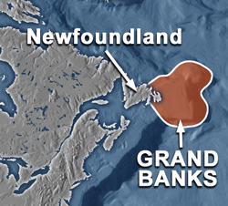
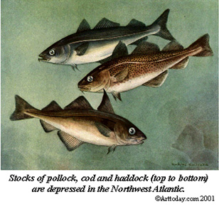
Fishing Banks- the best fishing areas located in the warm shallow waters of the continental shelf
Ground fish- live on the ocean floor along the bottom of the shallow continental shelves. Ex. Sole, halibut, pollock and cod…usually caught by trawlers

Slide 4
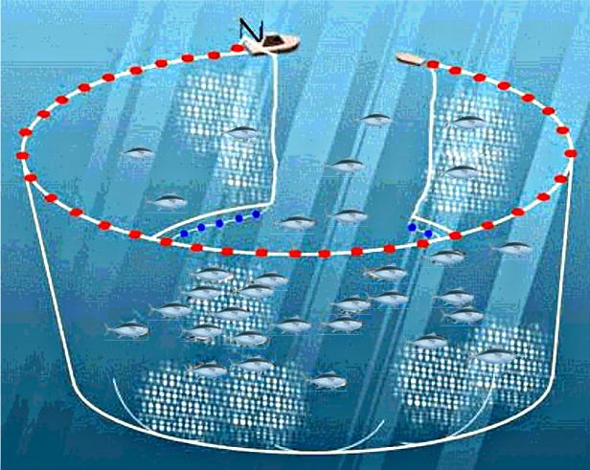
Pelagic fish- fish that swim in open water. Ex. Mackerel, herring, tuna and salmon..often caught by long liners with purse seine nets.

Slide 5
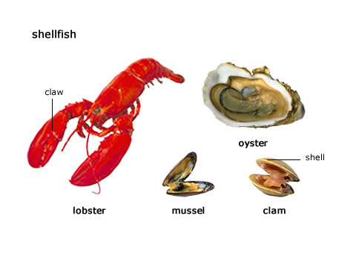
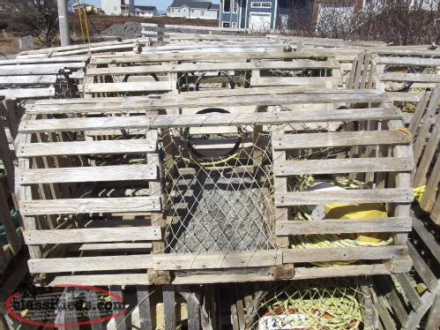
Shellfish- includes lobster, crab, oysters, scallops, and mussels, found on the ocean bottomand are usually caught in traps or weirs

Slide 6
Over fishing-catching too many fish which puts the stocks at risk.
By catch-nets accidentally catch small fish and other marine animals. This is a serious issue
Quota- the amount of species that may be caught by one boat or group of fishers per year. Quotas are obtained from the federal government
Figure 6.32 page 266

Slide 7
Reasons for Decline in Fish Stocks
1. Harmful technology
2. Overfishing( ignoring quotas, by catch discarded)
3. 200 mile limit too late

Slide 8
Questions
Advantages and disadvantages of technology #3 pg 271
Decisions by government to help fish stocks recover #4 pg 271
Recovering fish stocks pg 271 # 6

Slide 9
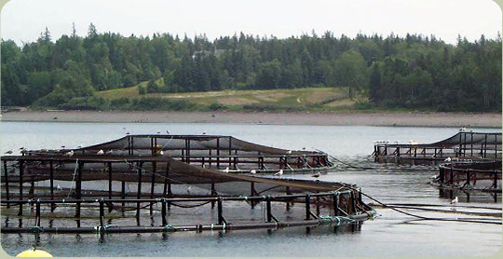
Aquaculture
Also known as fish farming , could be the way to feed the world in the future
Most fish farms raise salmon, but there is also shrimp and trout
Fig. 6.34

Slide 10
Aquaculture
Aquaculture is a good way to get protein from the sea but there are problems.
Wild species are affected when exotic species are introduced accidental release of culture fish.
Bioaccumulation of some chemicals makes farmed fish sometimes unfit for human consumption.
There is an increase in pollution as the fish are concentrated in small areas and their excrement produces high levels of algae and low oxygen levels in the water.
If done correctly it is a sustainable alternative to fishing.

Slide 11
