Slide 1
UNIT 5
URBAN AND RURAL CANADA: BUILDING SUSTAINABLE COMMUNITIES

Slide 2
Look at the photographs on p. 196
What do you see in each?
Which of the cities would you prefer to visit? Why?

Slide 3
Where Do Canadians live?
1.The majority of Canadians live in cities
WHY?
Cities…
Provide services for people
Large enough to support universities, sports teams, and other major cultural activities
Source of most technological innovation
Engines of economic growth for their province/territory or even the country

Slide 4
2. URBAN VS RURAL COMMUNITIES
There are a wide variety of communities in Canada…
Hamlet -> Fewer than 200 people (Swift Current)
Village -> 200-800 people (Rushoon)
Town ->1,000-10,000 people (Carbonear)
City -> Greater than 10,000 people (St. John’s)
Census Metropolitan Area (CMA)-> Greater than 100,000 people
All of these communities exist throughout Canada

Slide 5
URBAN VS RURAL COMMUNITIES
Urban -> an area where lots of people live at a high density
Rural -> People are spread out at a low density
CMA is the largest and may contain both urban and rural areas
Therefore, with the 2011 census, Statistics Canada created the term population centre to more specifically define urban areas
An area with at least 1,000 people and a density of at least 400 people per square kilometre
Where do you live????

Slide 6
URBAN VS RURAL COMMUNITIES
Population Centres are divided into THREE categories
Small Population Centre
Between 1,000 and 29,999 people
Medium Population Centre
Between 30,000 and 99,999 people
Large Population Centre
100,000 people or more

Slide 7
URBAN VS RURAL COMMUNITIES
OK, now back to CMAs
A CMA is made up of one or more neighbouring municipalities located around the urban core
Example…St. John’s
Closely surrounded by which municipalities?
A CMA must have at least 100,000 people total and at least 50,000 in its core
Does St. John’s and surrounding areas qualify as a CMA???

Slide 8
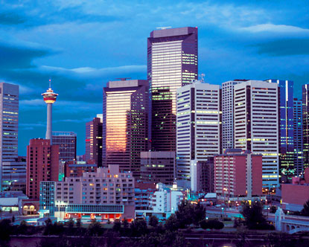
URBAN VS RURAL COMMUNITIES
Canadians continue to move to CMAs
10 fastest growing CMAs in Canada
Calgary, Alberta
Edmonton, Alberta
Saskatoon, Saskatchewan
Kelowna, BC
Moncton, NB
Vancouver, BC
Toronto, ON
Ottawa-Gatineau, ON
St. John’s NL
Brantford, ON

Slide 9
3.City Wise
Canada is one of the largest countries in terms of land area
However, it has a small population for its size
Why???
Difficult to build cities in many areas
Northern Canada
Swamplands surrounding Hudson Bay
Some places are better suited for resource development than city building

Slide 10
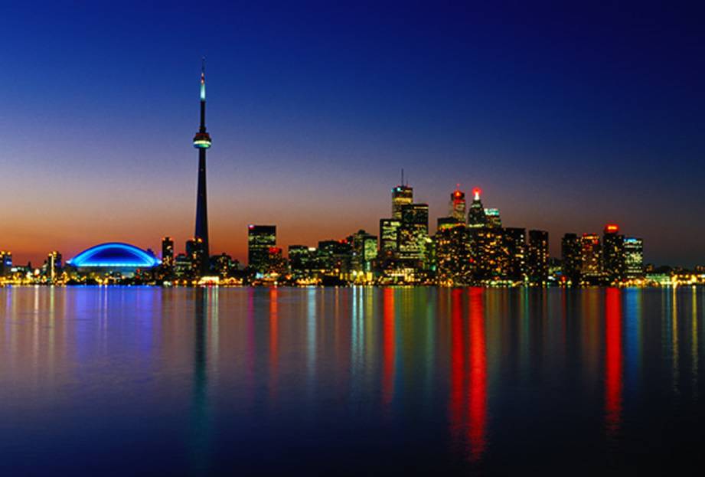
City Wise
Some people choose to live in rural areas
Most decide to live in urban areas
81% of Canadians live in large population centres
The three largest are:
Toronto
Montreal
Vancouver
35% of all Canadians live in these three population centres!!!!

Slide 11
City Wise
As mentioned earlier…
81% live in population centres
See Figure 5.2 on page 200
Over 80% of Canadians live in _______% of the country
Therefore Urbanization is occurring in Canada
Growing trend of increasing numbers of people choosing to live in cities
Therefore, Canada is urbanized

Slide 12
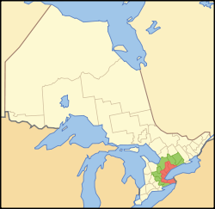
4.CANADA’S HEARTLAND
The Golden Horseshoe region in Southern Ontario and the Montreal region are very popular for settlement
Europeans were drawn
here for its climate and
rich soil
Today it is known as
Canada’s Heartland
Hub of Canada’s economic
and industrial activity

Slide 13
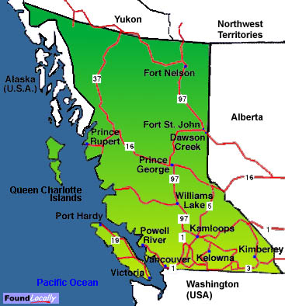
5.Western Canada
Natural Systems contributed to western Canada’s development
Southern BC saw many ports developed
WHY?
Close to Pacific Ocean (Made trade easy)
Trade with Who????

Slide 14
Western Canada
Area also has a moderate climate and plenty of fish stocks
Many forests further inland
These reasons have lead to the growth of Vancouver and Victoria and they remain very popular

Slide 15
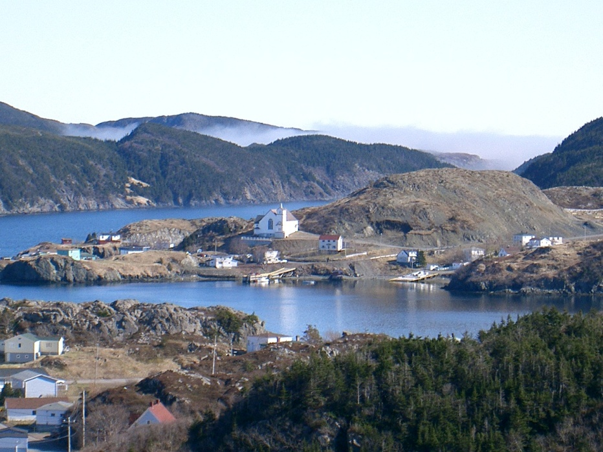
6.Resource-based Communities
20% of Canadians live in scattered rural communities
Most of these communities have grown around a primary industry
Fishing, forestry,
mining
These communities
face both major
opportunities or
major challenges…

Slide 16
Business Cycle
Often provides excellent employment
Leads to opportunities for businesses in that community
However, much profit from selling this resource doesn’t come back to the community
Back to shareholders of company
There is little Accumulation of Capital in resource-based communities
Also, resource could run out or demand for it could drop
Lead to serious economic challenges
This is the Business Cycle of resource-based communities

Slide 17
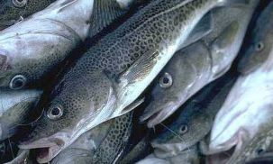
Example…Cod Moritorium
Many of these small communities struggle during these times
Struggle to retain infrastructure like schools and hospitals
Example…
Cod Moritorium (1992)
Federal Government placed a moritorium (ban) on cod fishing
Many fish plants and
employees without work
(moved to larger urban
centres)

Slide 18
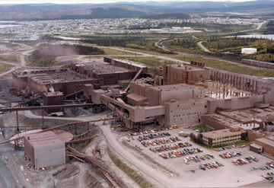
Example…Labrador City
Experiencing significant economic growth
Demand for iron ore (used to make steel) has soared
Especially from China and India
Although this growth is great for the community, there are still challenges
Competitive housing (very expensive now)

Slide 19
Handout # 1

Slide 20
Changing Imprints of the Landscape
Part 2 pgs.208-223

Slide 21
7. URBAN LAND USE
Land Use is a term that geographers and planners use to identify the different areas where we live, shop, work, play, and go to school
There are six main types of land use in Canada:
Residential Land Use
Transportation Land Use
Commercial Land Use
Industrial Land Use
Institutional Land Use
Open Space and Recreational Land Use

Slide 22
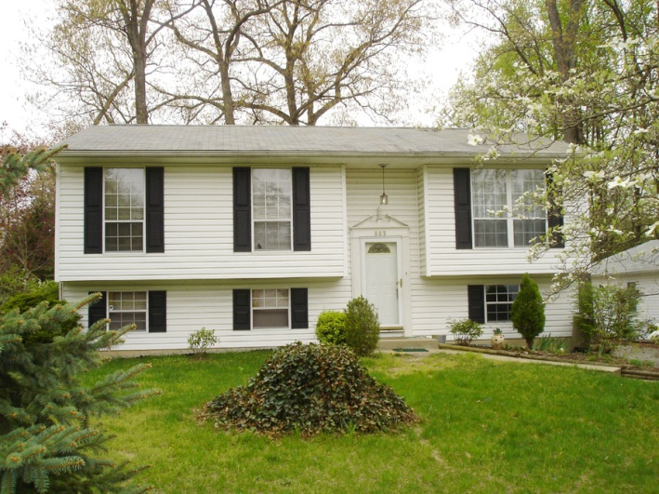
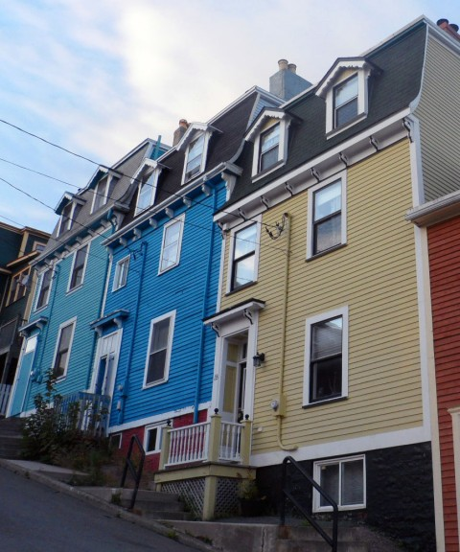
8. Residential Land Use
Refers to land be used for living space
Examples
Think of your community…
What do you see…
Single-family houses
Apartment buildings,
Townhouses (attached houses, usually take up little room, but have several floors)

Slide 23
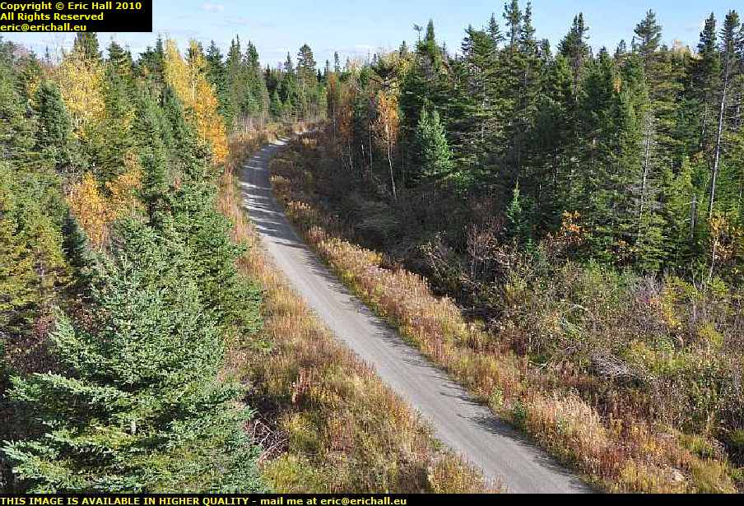
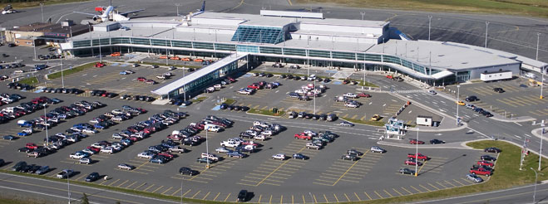
9.Transportation Land Use
Land used to move people from one place to another (Transportation Systems!)
Examples:
Roads, Subways, Trains, Airports, etc.

Slide 24
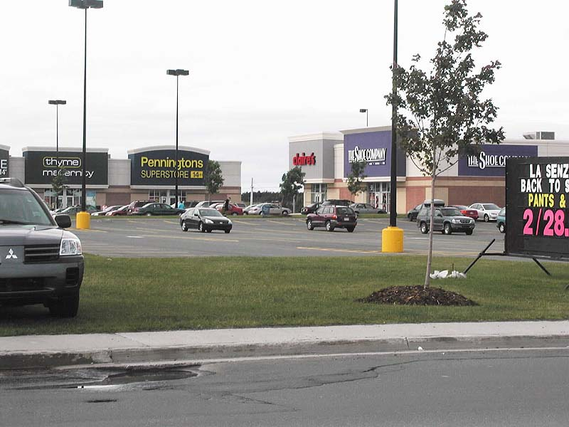
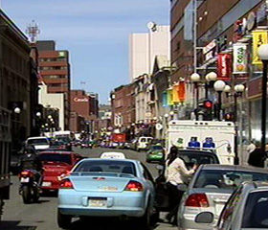
10.Commercial Land Use
Land being used for business activities, or buying and selling of goods and services
Examples…
Shopping Mall
Stavanger Drive
Kelsey Drive
Water Street

Slide 25
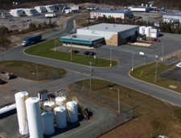
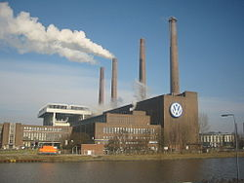
11.Industrial Land Use
Land used for secondary industries (Manufacturing)
Examples…
Factories
Warehouses
Usually located near major routes or highways so goods can be transported easily

Slide 26
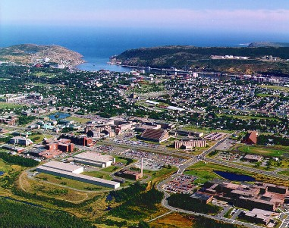
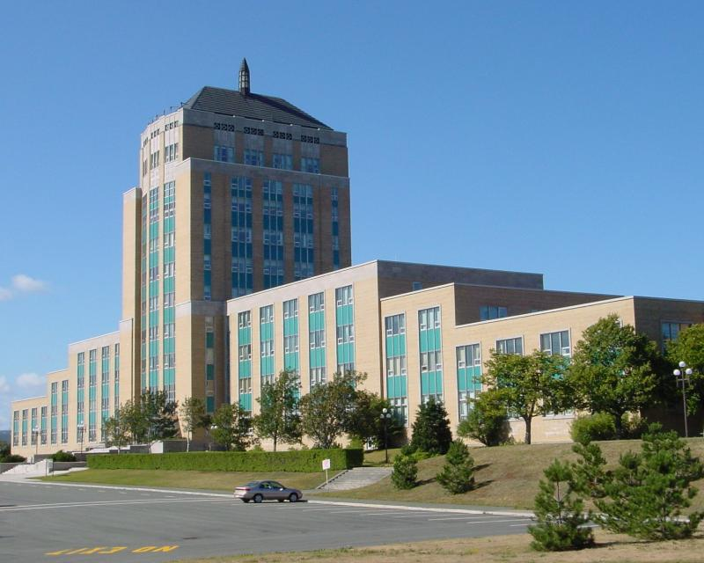
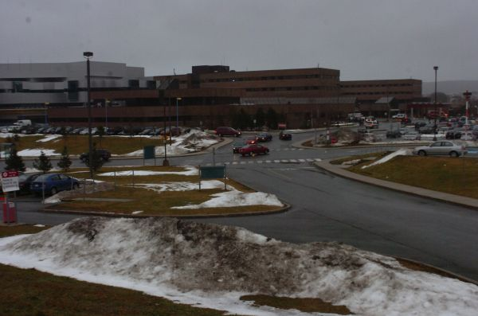
12.Institutional Land Use
Land used for schools, hospitals, places of worship and government offices

Slide 27
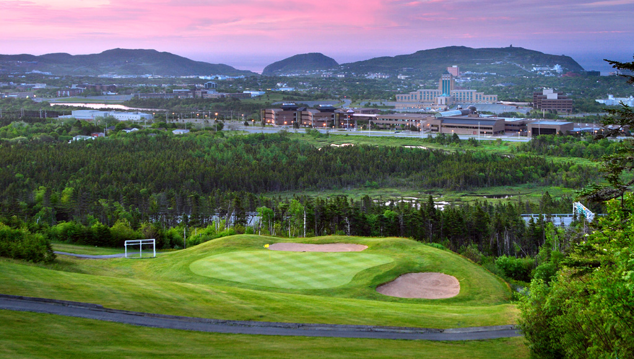
13.Open Space and Recreational Land Use
Open Space
Land that has been left in its natural state
Examples…
Forests
Recreational
Land used for recreation activities
Examples…
Playgrounds
Parks
Golf courses
Fields

Slide 28
14. Land Use Planning
We face big challenges in land use planning
We need to provide housing for a growing population and maintain prosperous urban economy
However, we must also satisfy the need for green open space and protect wildlife habitats around urban places
These decisions are made by urban and transportation planners, politicians, developers and citizens
There may be many issues in making these decisions

Slide 29
Land Use Planning
Handout #2

Slide 30
15. Canada’s Booming Urban Centres
After World War II, many couples were reunited and decided to start families
At the same time, the use of automobiles became more common
This lead to many people moving outside cities into the surrounding areas
This marked the birth of the suburbs
Many banks, restaurants, hospitals, etc. moved to the suburbs with the people
Canadians no longer had to commute for all their needs

Slide 31
Handout #3 and Handout #4

Slide 32
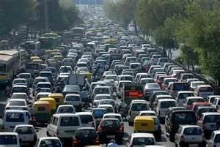
16.Urban Sprawl
Urban Sprawl ->Outward expansion of urban centres to nearby bordering areas
As cities grow, many issues arise…
Traffic congestion
Overburdened services
Air Pollution
Planning for efficient mass transit
Managing wastes
Containing urban sprawl
As communities grow,
many natural and human
systems are at risk

Slide 33
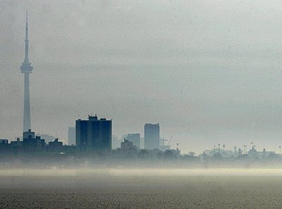
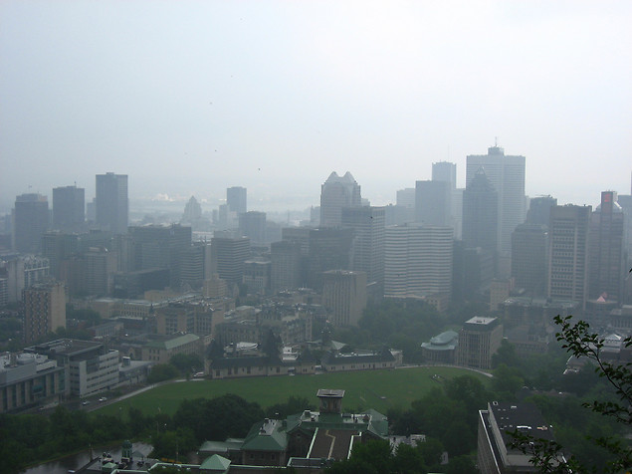
17.Smog
Smog -> Combination of pollutants (gases, particles) that form a haze over a city
According to Environment Canada, 95% of smog is caused by burning fuels in vehicles
Urban areas need to be able to grow while remaining sustainable

Slide 34
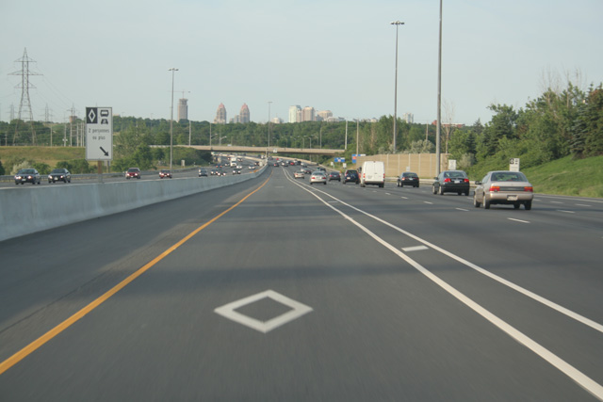
HOV
One way cities have attempted to decrease smog is the availability of High-Occupancy Vehicle (HOV)lanes
Lanes solely used by buses and vehicles with at least two people
Designed to help move more people through busy areas
quickly
Help ease congestion
in regular lanes
HOV lanes currently
exist in the Greater
Toronto area

Slide 35
18. Waste Management
As populations in urban areas increase, so does the amount of waste produced
Many communities have a recycling and composting program in place to combat this
“Curb It St. John’s”
Although these programs exist, recycling is still an issue
How can we fix this???
Other areas are also transporting their waste to other areas
Great Pacific Garbage Patch Article
The real solution is to reduce

Slide 36
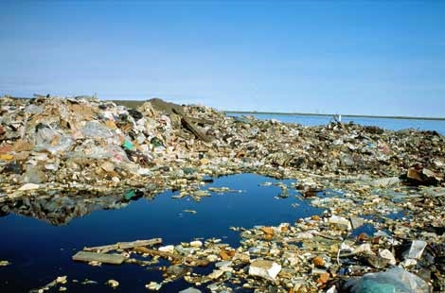
Great Pacific Garbage Patch

Slide 37
Handout # 5

Slide 38
Making Cities Greater Places to Live
Part 3 pgs. 224-235

Slide 39
19. The Future of Cities
Canada’s cities are constantly changing
Many communities that grew into suburbs have become much more developed
There is a bigger focus on pedestrian walkways in cities today
WHY???
Fitness
Environmentally friendly

Slide 40
20. Smart Growth Solutions
New designs for urban planning is called Smart Growth
Focuses on plans for urban expansion while also preserving the natural environment
Smart Growth focuses on placing more people in smaller areas
Houses that take up less land area
Apartment buildings
Retail, schools, entertainment located very close by

Slide 41
Smart Growth Principles
Develop in existing communities, making them more compact and dense, rather than suburbs that spread into rural areas
Mix land uses: put homes, offices, stores and services in the same neighborhoods within walking distance
Create a range of housing opportunities that will bring together people of different ages, household types, incomes, ethnicities
Provide a variety of transportation choices, including public transit
Create places and routes for safe walking and biking
Protect green space, farmland, and ecologically sensitive land, such as wetlands
Protect wildlife habitat by creating natural corridors through urban areas, so wildlife can roam freely

Slide 42
21. Green Technologies
Environmentally friendly ways of constructing buildings
Becoming very popular
Alternate forms of energy are being looked at for widespread urban use
EXAMPLES???
Sustainability also exists in building homes
Old tires to create rubber roofing tiles
Green roofs (Gardens on rooftops) are becoming more popular (Schools)
Help soak up runoff that would carry pollutants to water supply

Slide 43
22. Telecommuting
The process of commuting electronically to work
Many people now use technology to connect with the workplace from home or on the road
Avoids traffic
“1 million telecommunters working from home for one day a week saves
250 million kg of Carbon Dioxide
$40 million in fuel
Over 800 fewer km of mileage

Slide 44
Telecommunting
Many environmental benefits
Most important…
Commuting is eliminated
Congestion and pollution levels drop
Smart phones, tablets and laptops make it much easier to connect with others
Online conferences can replace face to face meetings

Slide 45
Handout # 6

Slide 46
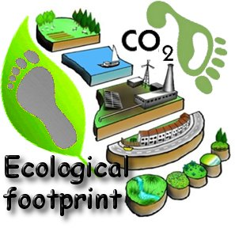
23.How Big Is Your Ecological Footprint?
Ecological footprint – the amount of Earth’s resources it takes to support your lifestyle
Measured in hectares
World average footprint – 2.2 hectares
Canadian average – 7.0 hectares

Slide 47
Ecological Footprint
Your footprint is made up of many factors
Water use
Transportation use
Space used for work or play
How much money you spend
How far food you eat is shipped
How much living space you have
How much garbage you create

Slide 48
Handout # 7

