Slide 1
Water
The essence of Life

Slide 2
The Comforts of Home
Pg 296
Is water more than a natural resource?
Ethics of water ethics are a set of principles , or your beliefs about what is right or wrong.
Can anyone really own water?
Should it be sold ?
Or is it a right?

Slide 3
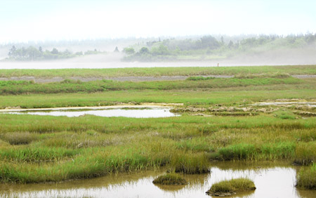
Views about Water
Read pg 298-299
Canada has 20% of the worlds fresh water
We have 25% of the worlds wetlands- marsh, swamp, or fen(low land covered with shallow water)

Slide 4
Protecting our Water Resources
Safe drinking water in Canada
Some sources have unacceptable levels of disease-causing bacteria, viruses, or chemical contaminants
Reasons why: 1. logging or mining operations
2. maintaining water pipe sand storage tanks
3. lack of financial resources to build and monitor water treatment systems

Slide 5
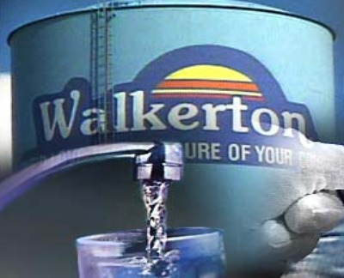
E. Coli
Water crisis in Walkerton, Ontario
Killed 7 and made 2300 ill.
In Nl over 150 communities can be under a boil order at any given time

