Slide 1
Work and Working Arrangements
Unit Three

Slide 2
Definitions
Job- regular work at one place for which you receive payment
Occupation-refers to a group of similar jobs found in different industries or organizations(education, health, engineers)
Career-course of ones life in which work and other activities are intergrated to achieve personal goals

Slide 3
Types of Workers\Jobs
1.Part-time workers: work from 1-34 hours for the majority of weeks in a year.
2. casual workers- hired on from time to time for short periods to fulfill specific requirements
3. permanent / temporary fulltime workers-work more than 35 hours for the majority of weeks in a year

Slide 4
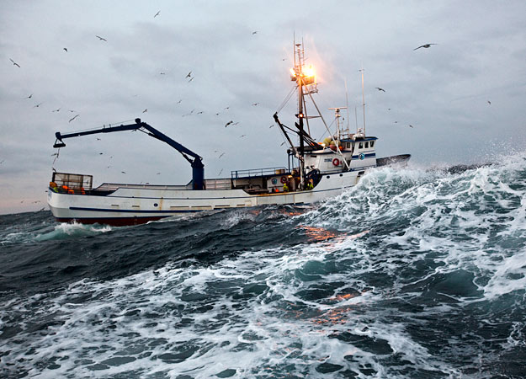
4. seasonal workers- work in industries that operate within specific seasons. (farming ,fishing)

Slide 5
5. agent/ broker- often works evenings and weekends and usually are called on to suit the needs of their clients(real estate)
6. contractual workers-contract out their services to an employer for a specific period of time and amount of work. Salary is agreed upon before the contract begins

Slide 6
7. project –based teamwork worker- work in groups to complete projects. Each worker takes responsibility for an aspect of the project
8. freelance worker- self-employed working in a profession or trade in which fulltime employment by a single employer is also common
9. consulting workers-help companies to improve performance through analysis of existing problems and development of future plans, best practices, technology,and strategy development

Slide 7
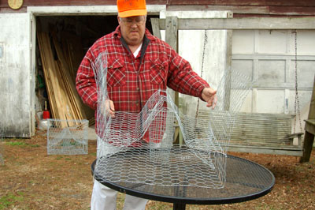
10. piecework workers- get paid according to the quality of work they produce. ( crabpots)
11. entrepreneurship worker- start their own business by assuming financial risk of the initiation, operation and management of the business

Slide 8
Types of Working Arrangements

Slide 9
1. telecommuting workers-working at an alternate site, such as home, usually one or two days a month, reducing their commutes
2. flextime workers-having a non-traditional work schedule, that allows them to meet their personal needs

Slide 10
3. work sharing workers sharing a reduced work week with their co-workers as a result of downsizing at the workplace.
4. compressed workweek workers- work more hours per day, but fewer days over the course of one or two weeks
5. home based worker-work from home in either self employment or of companies

Slide 11
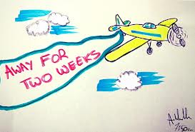
6. leave time- workers can avail of leave time for a variety of reasons paid or unpaid…(sick leave, maternity, educational, annual, sabbatical)
7. phased retirement-close to retirement date and can reduce their work weeks leading up to it and gradually ease into retirement

Slide 12
National Occupational Classification

Slide 13
The NOC is a list that describes and classifies Canadian occupations. It provides descriptions for more than 520 occupational unit groups and about 30,000 occupational titles.
The info included is available online
It is used by groups such as JOB FUTURES
Refer to pages 112-114 in text
Complete activity pg 113and 114

